Slide 1
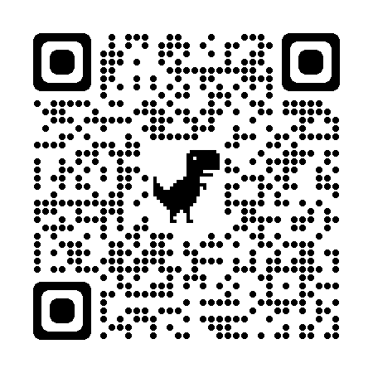
An introduction to AI tools
jsoma.github.io/2023-abraji-ai-workshop
investigate.ai
normalai.org
Jonathan Soma
Columbia University
@dangerscarf
js4571@columbia.edu

Slide 2
The roadmap
STEP ZERO

Slide 3
What is a “model?”
Sentiment analysis + text classification
Training and fine-tuning models
Large language models (and limitations)
Beyond text models

Slide 4
What is a “model?”
STEP ONE

Slide 5
Words you may have heard
GPT-2, GPT-3, GPT-3.5-turbo, GPT-4, Bard, Claude, LLaMa, Stable Diffusion, Midjourney, DALL-E 2, Imagen
Let’s learn what they mean

Slide 6



model
input
output

Slide 7
Sentiment analysis
STEP ONE, PART ONE
I love to eat cookies is POSITIVE
I hate when it rains is NEGATIVE

Slide 8



sentiment analysis model
text
POSITIVE or NEGATIVE

Slide 9
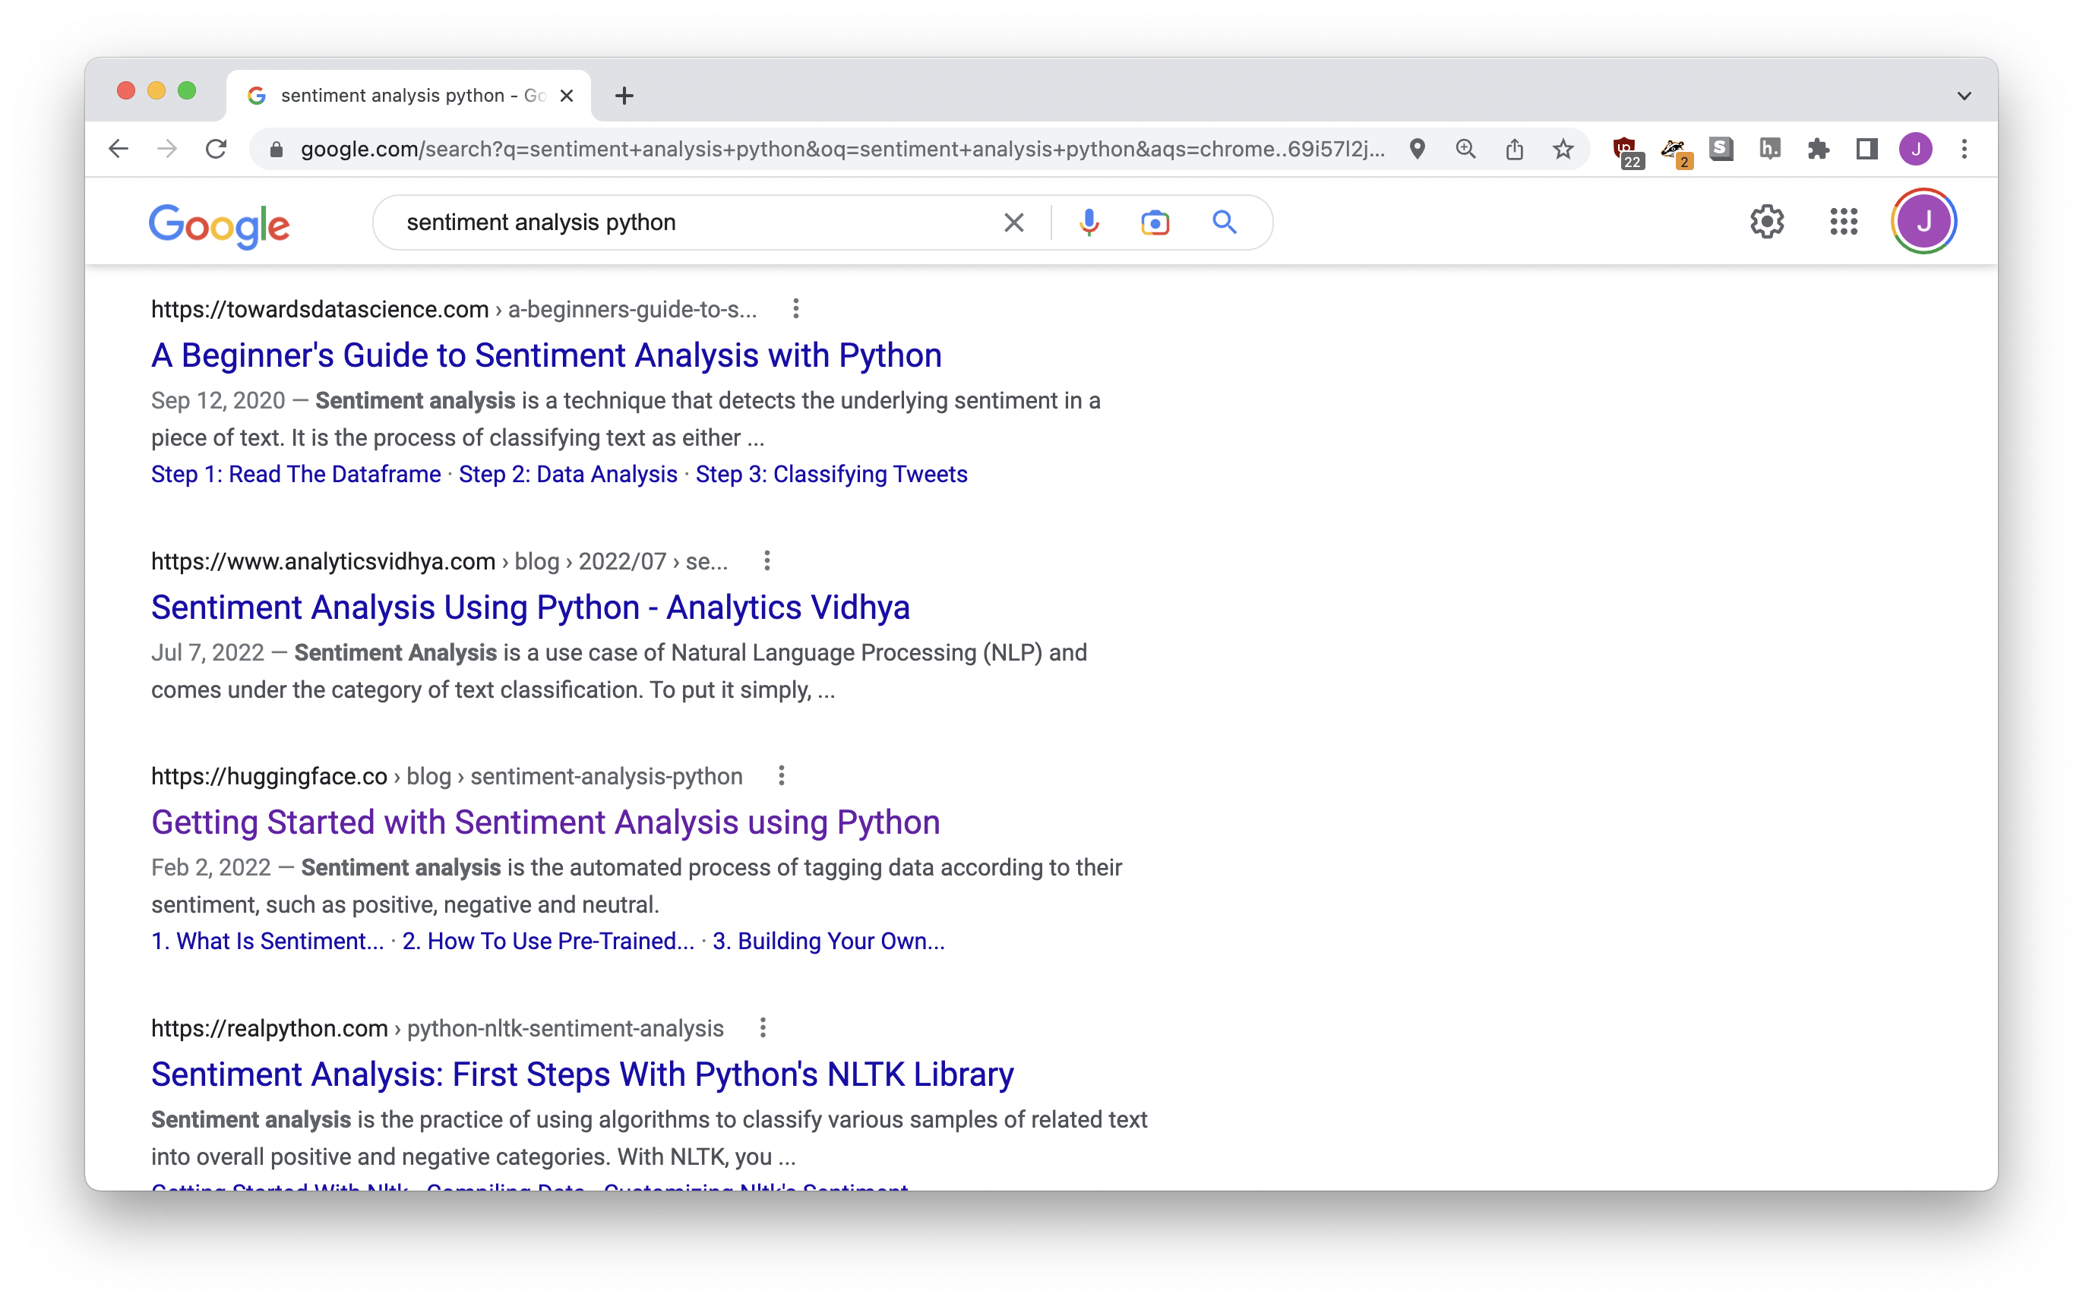


Slide 10
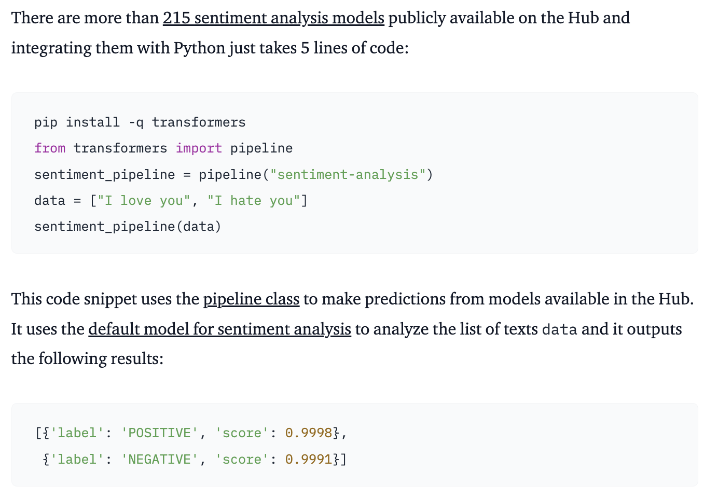

Slide 11
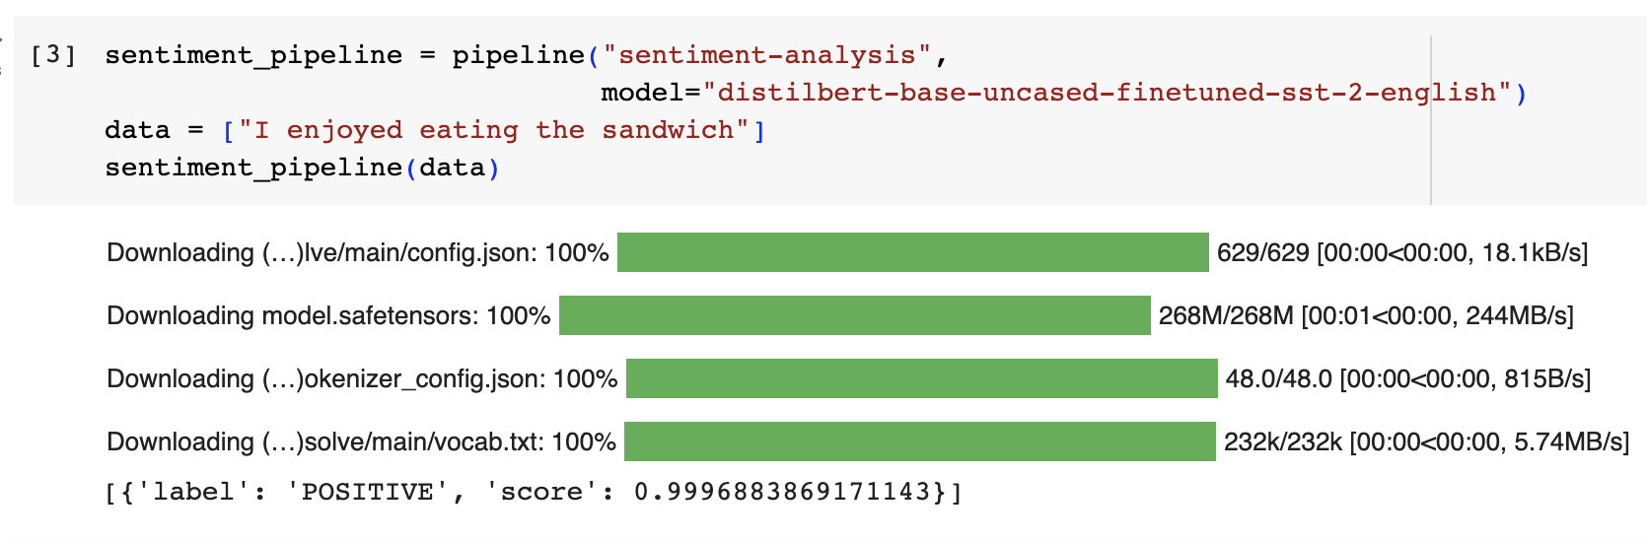
[{
'label': 'POSITIVE’,
'score': 0.999688386171143
}]
Notes:
It does some stuff but we also get in trouble

Slide 12
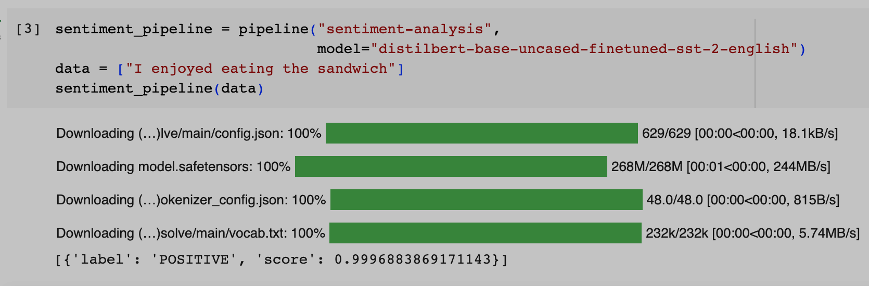


“model”!!!
Notes:
It does some stuff but we also get in trouble

Slide 13
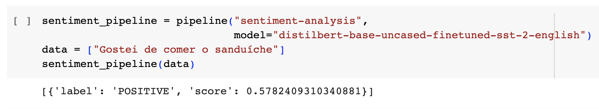


distilbert-base-uncased-finetuned-sst-2-english
[{
'label': 'POSITIVE’,
'score’: 0.5782409210340881
}]

Slide 14
distilbert-base-uncased-finetuned-sst-2-english
“english”

Slide 15
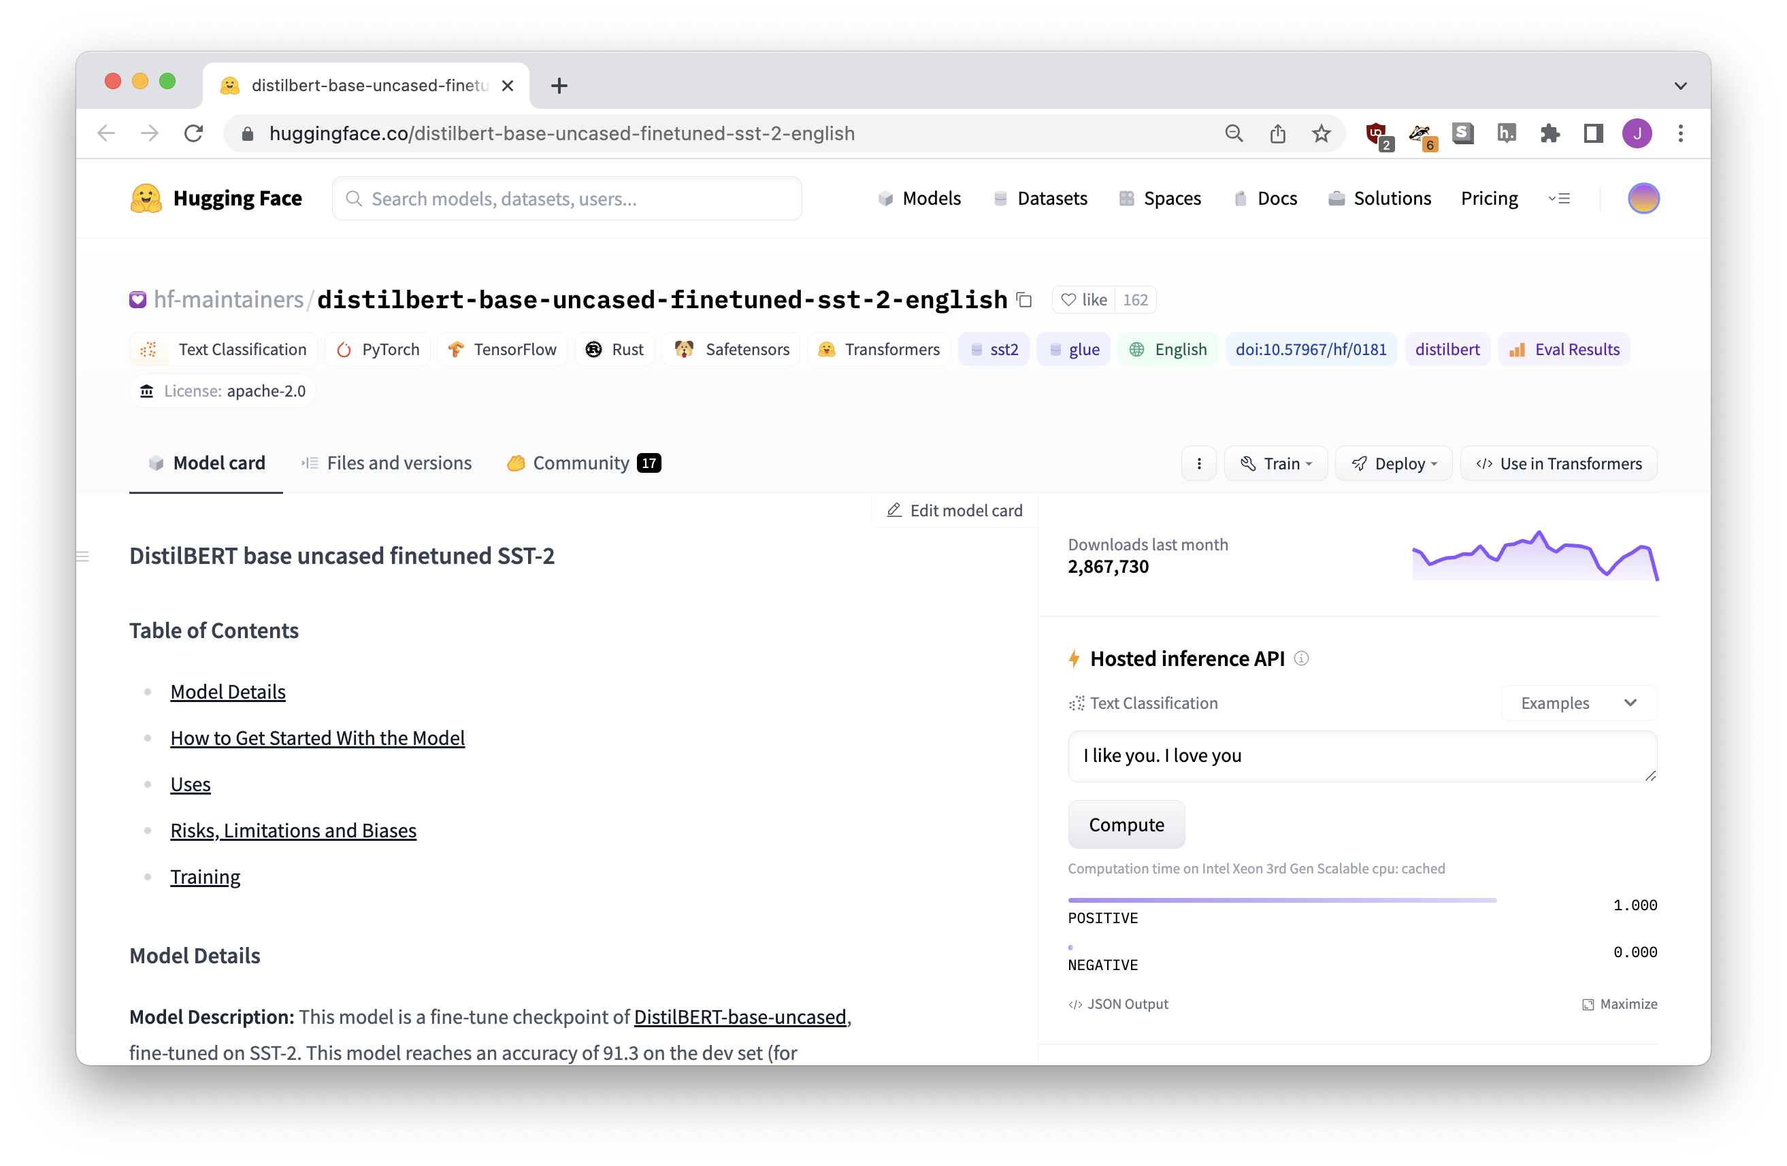
huggingface.co
(where all the models live)

Slide 16
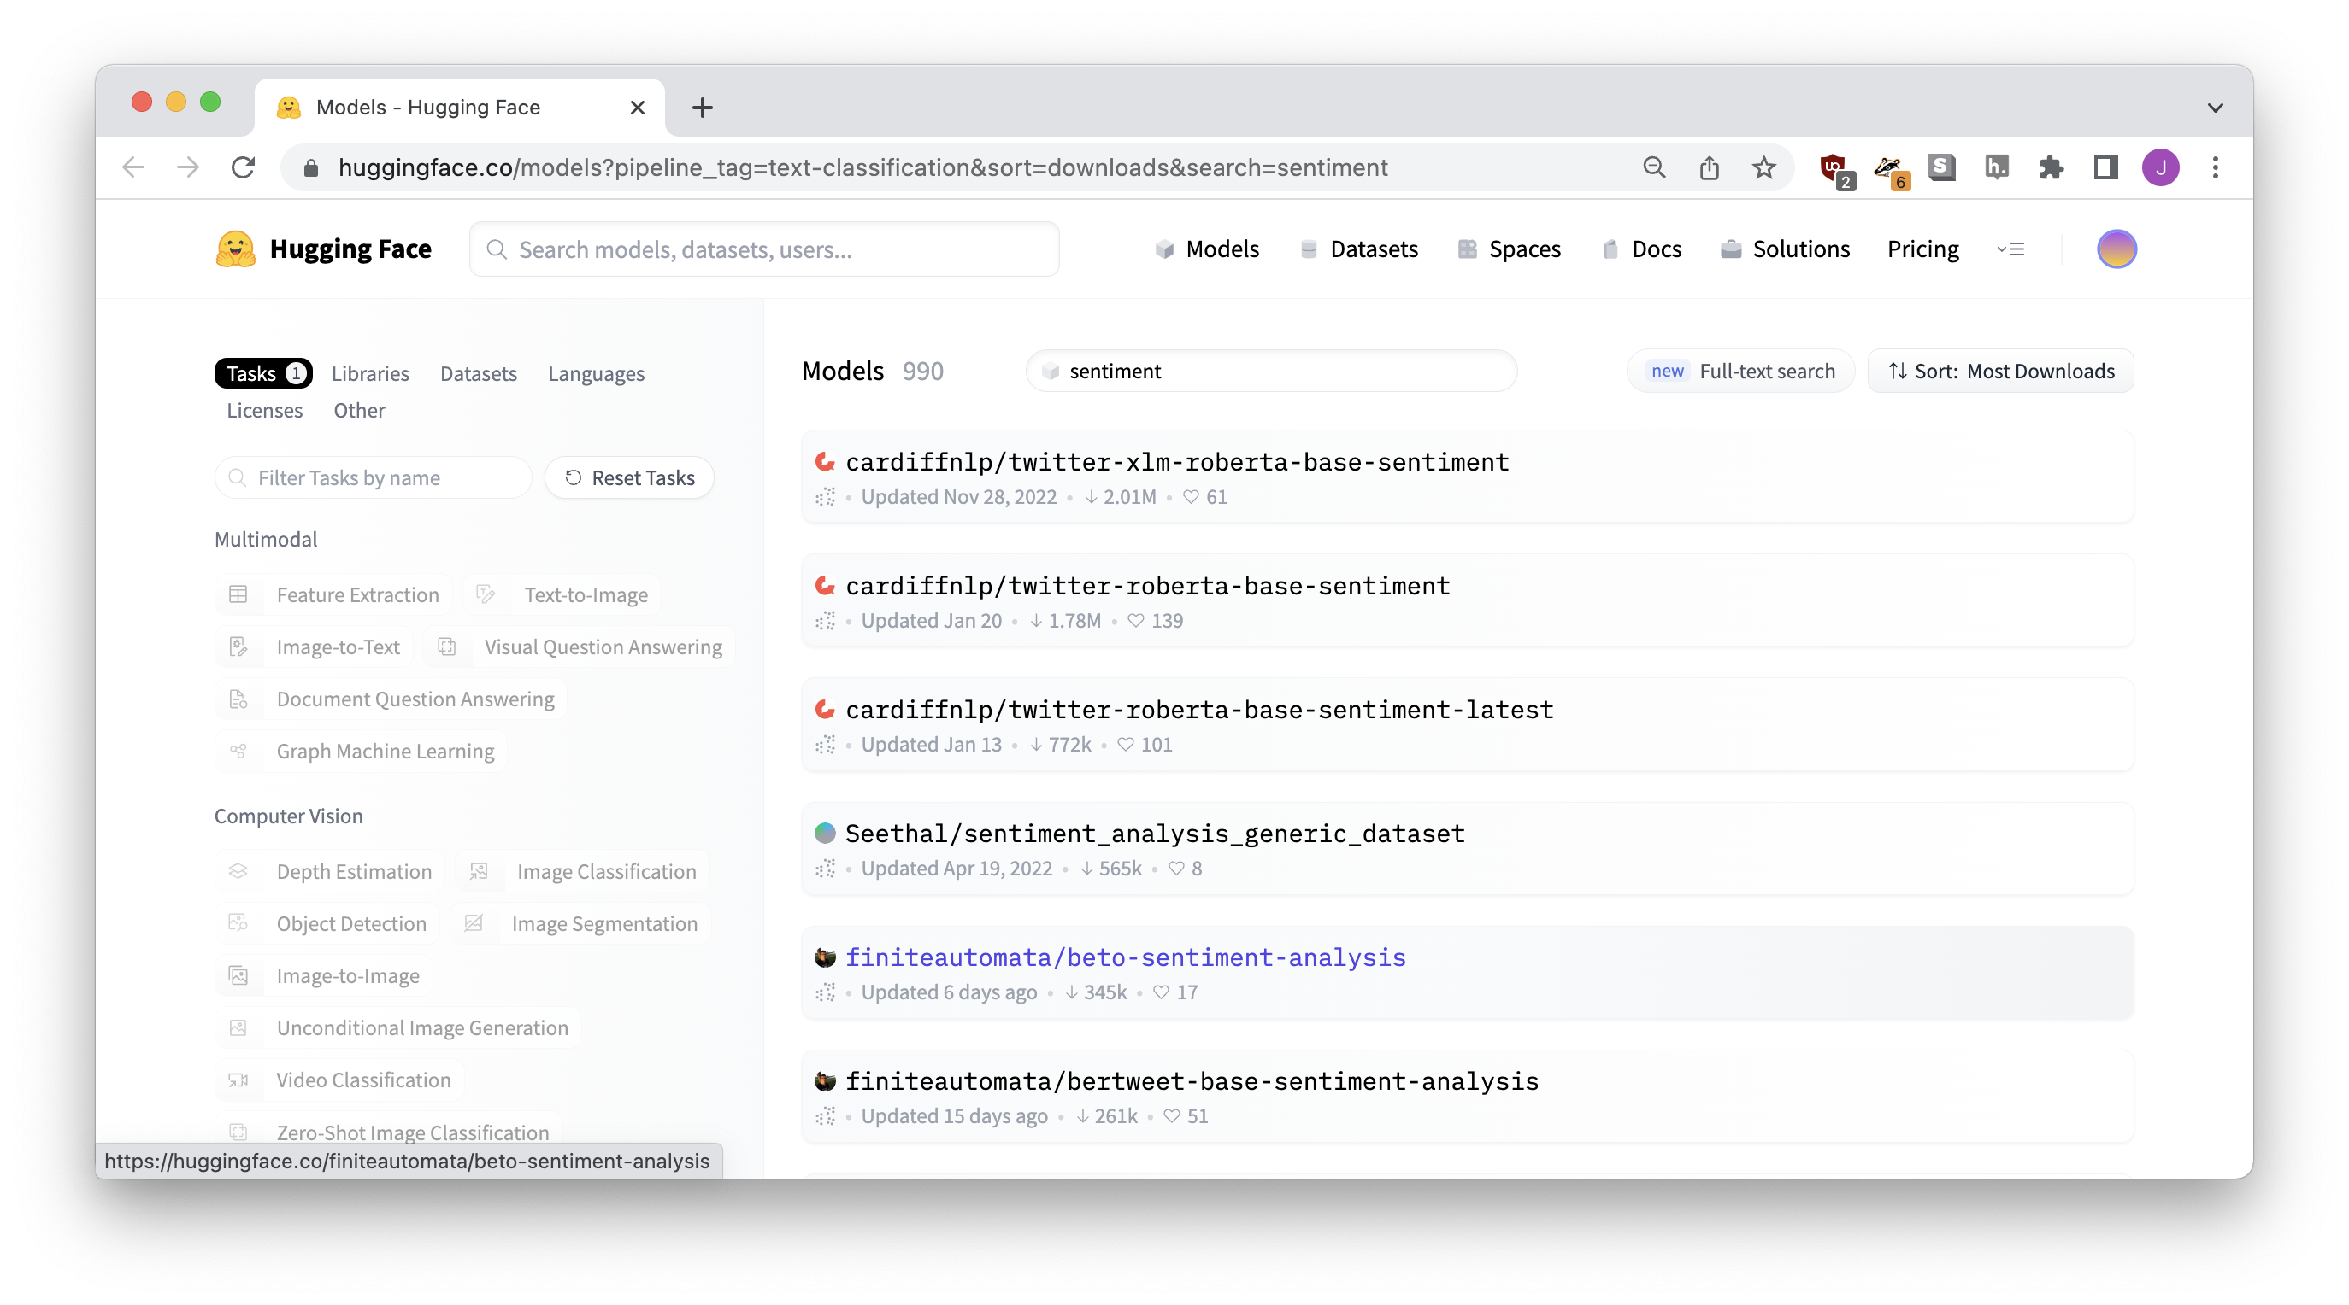
Notes:
I don’t know what’s going on but the first one is obviously the most popular

Slide 17
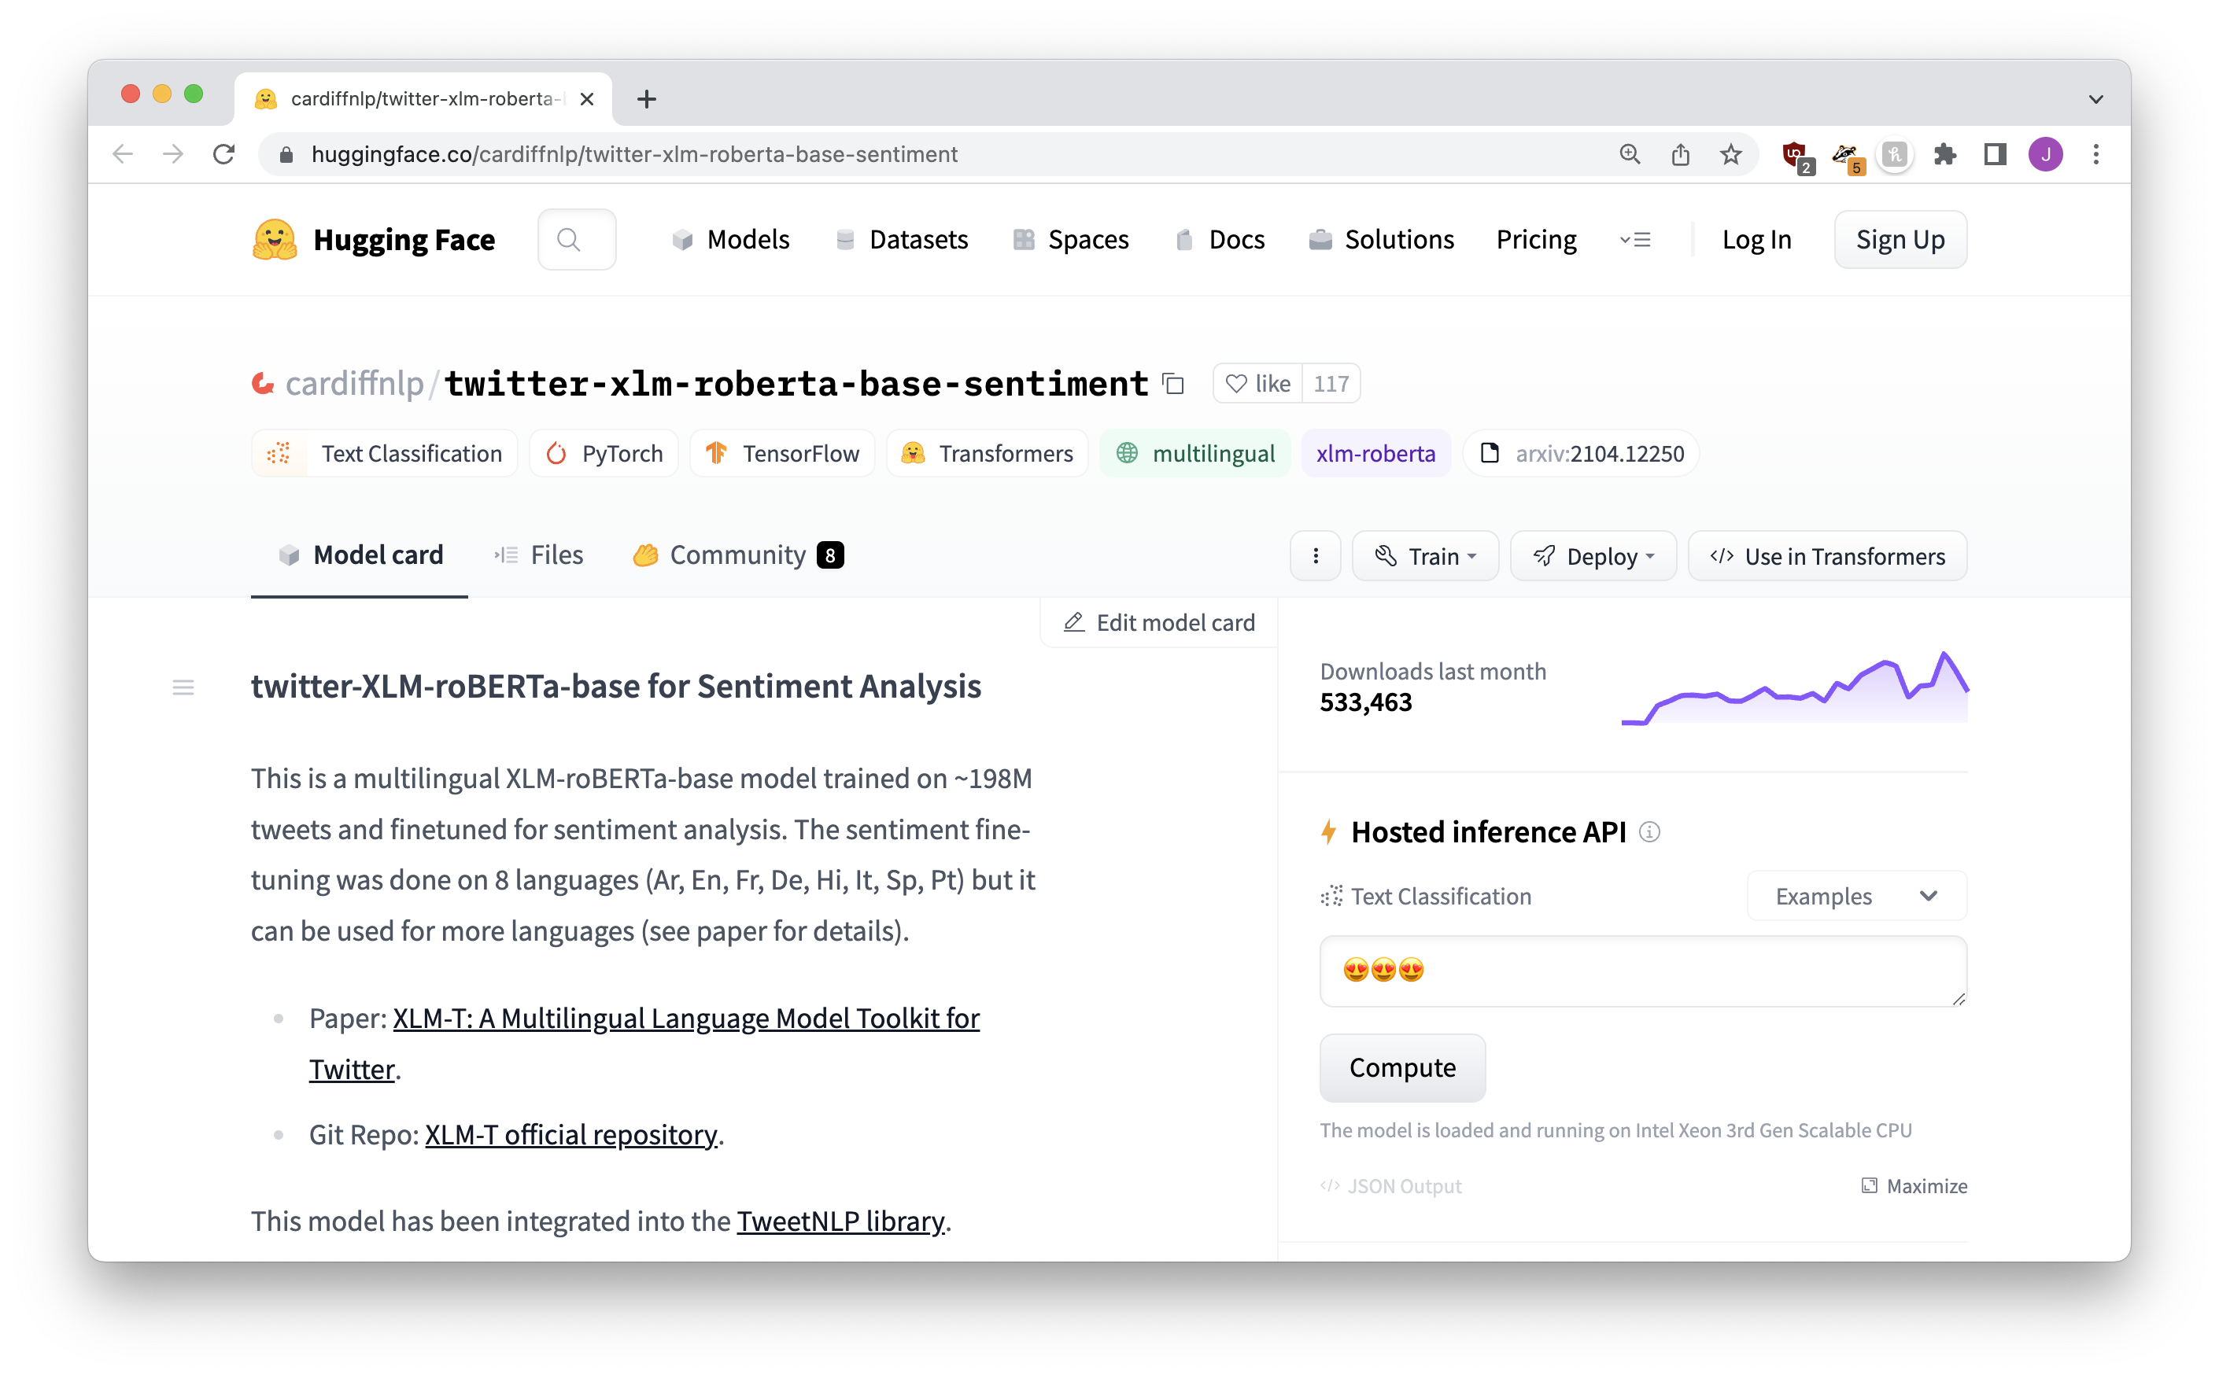

Slide 18
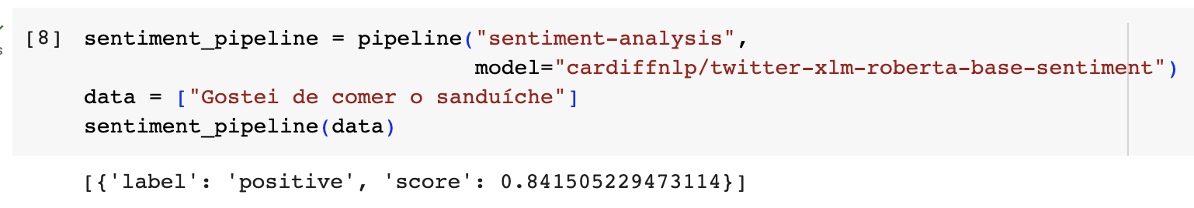
[{
'label': 'POSITIVE’,
'score’: 0.841505229473114
}]

Slide 19





english model
not great
portuguese text
multi-language model
better
Notes:
There isn’t just ONE sentiment analysis

Slide 20
There isn’t just one “sentiment analysis” – different models give different results!
Different models might perform better or worse at different tasks or languages
But why?? How?? Where do they come from??

Slide 21
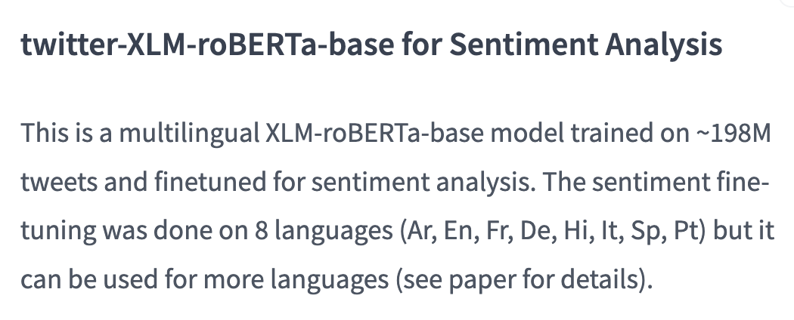



Slide 22
Training
STEP TWO

Slide 23


I love to eat cookies is POSITIVE
I hate when it rains is NEGATIVE
I’m feeling sick is NEGATIVE
Dogs are cool animals is POSITIVE
…… is …….
…… is …….
TRAINING
MODEL
…… is …….

Slide 24
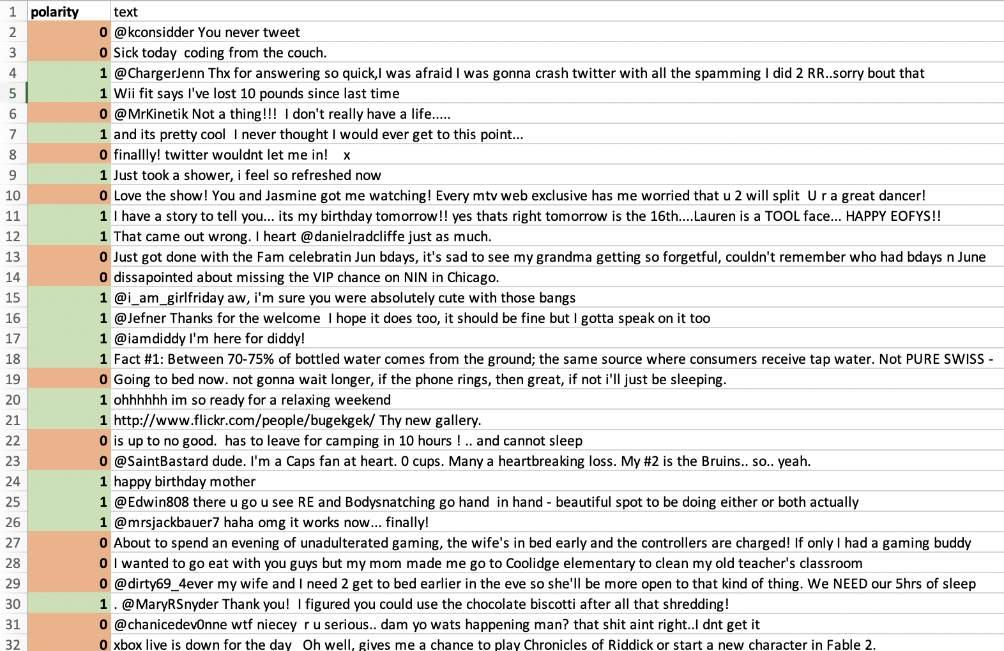
YOU LABEL!
IT LEARNS!
”hate”
”love”
”cry”

Slide 25
sentiment analysis model
POSITIVE or NEGATIVE
text

Slide 26
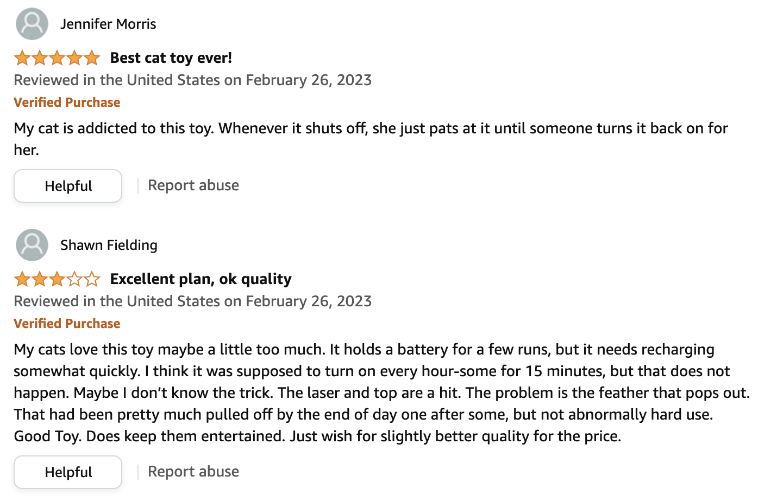
YOU CAN TRAIN ON ANY KIND OF CATEGORIES!!!!

Slide 27
classification model
text
category

Slide 28
Train your own models!
Crimes!
Misinformation!
Hate speech!

Slide 29
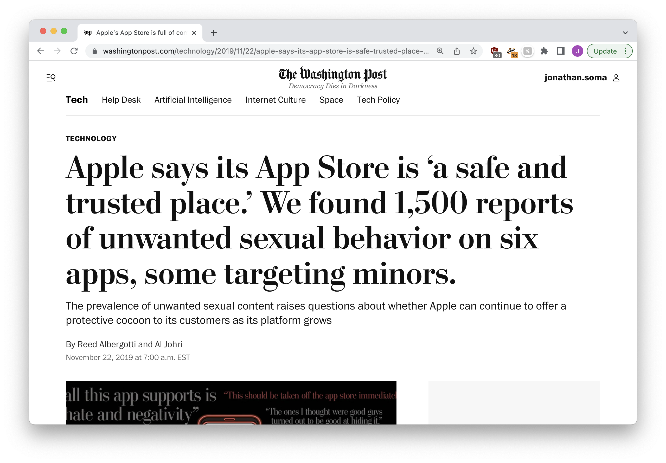

Slide 30
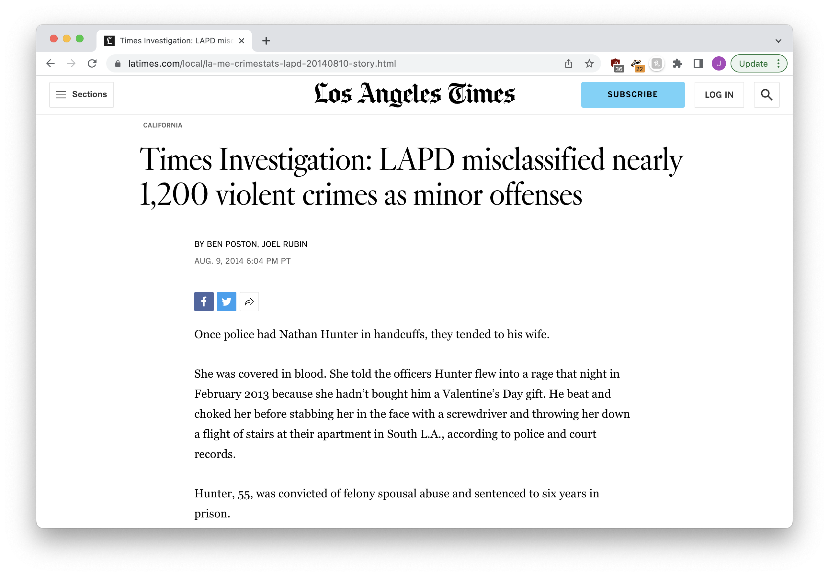

Slide 31
There’s a tiny problem (language is bad and awkward)
STEP THREE

Slide 32
❌ “I hate you”
❌ “They hate you”
❓ “He hates you”
same word, but different endings
Notes:
Is an intern or a computer going to be better at understanding this?

Slide 33
fish
fishes
fishing
fished
correr
correndo
correu
correm
Notes:
Is an intern or a computer going to be better at understanding this?

Slide 34
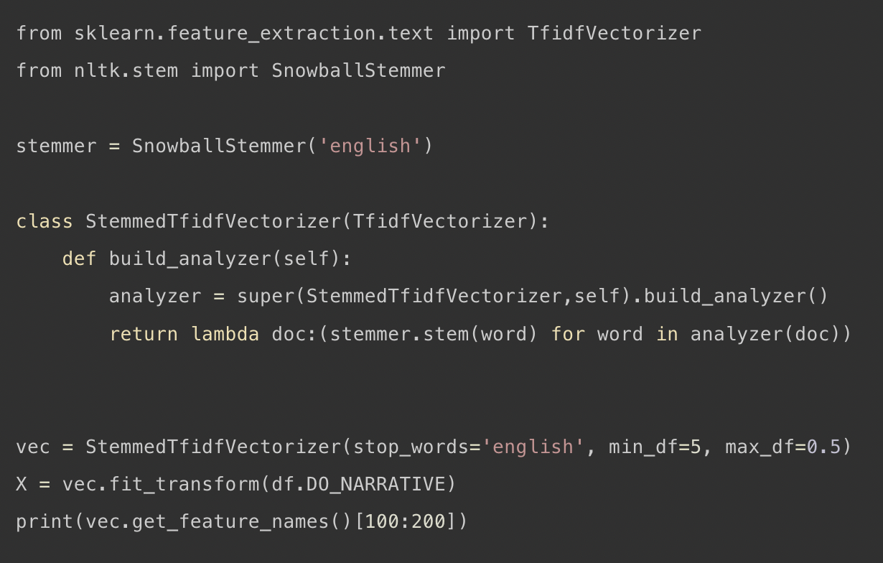
there are ways to solve it…
Notes:
Does this make us happy? No we don’t like it
So let’s get ready to hire some interns, yeah?

Slide 35
Fine-tuning
STEP FOUR

Slide 36


I love to eat cookies is POSITIVE
I hate when it rains is NEGATIVE
I’m feeling sick is NEGATIVE
Dogs are cool animals is POSITIVE
…… is …….
…… is …….
learn rules
…… is …….
TRAINING

Slide 37
A WHOLE LOT OF TEXT
learn language
TRAINING

Slide 38


A WHOLE LOT OF TEXT
TRAINING
(to learn language)
I love to eat cookies is POSITIVE
OKAY NOW
WE USE IT!!!!
I hate when it rains is NEGATIVE
I’m feeling sick is NEGATIVE
Dogs are cool animals is POSITIVE
…… is …….
FINE TUNING
…… is …….
…… is …….
(to learn rules)

Slide 40


198 million
tweets
TRAINING
(to learn language)
I love to eat cookies is POSITIVE
OKAY NOW
WE USE IT!!!!
I hate when it rains is NEGATIVE
I’m feeling sick is NEGATIVE
Dogs are cool animals is POSITIVE
…… is …….
FINE TUNING
…… is …….
…… is …….
(to learn rules)

Slide 41
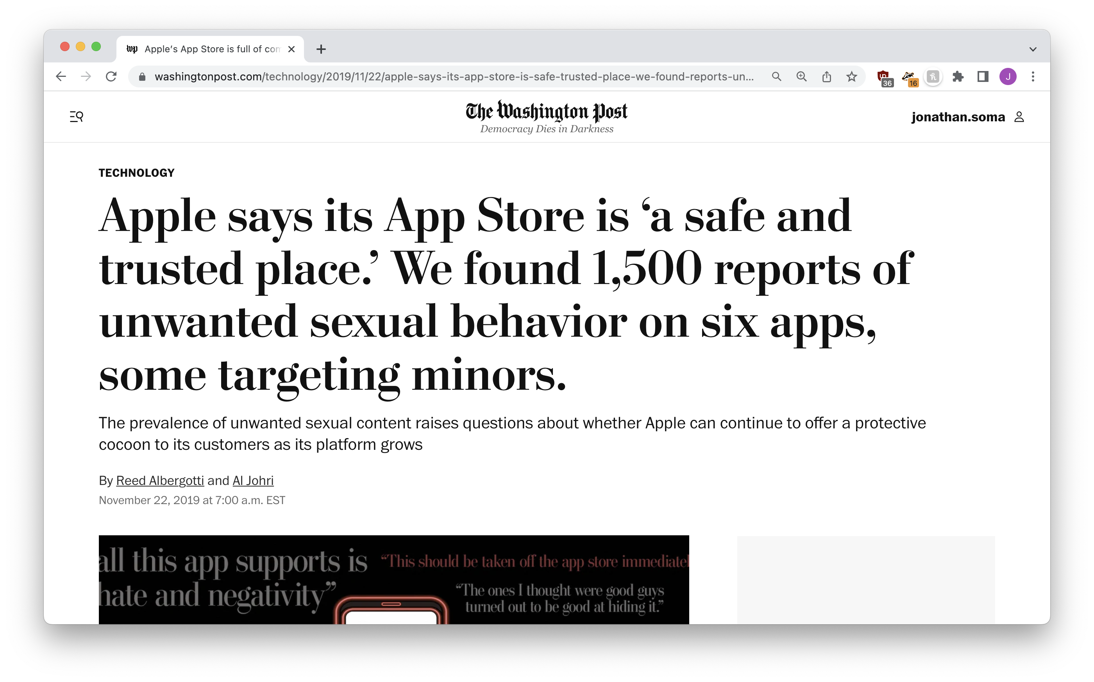
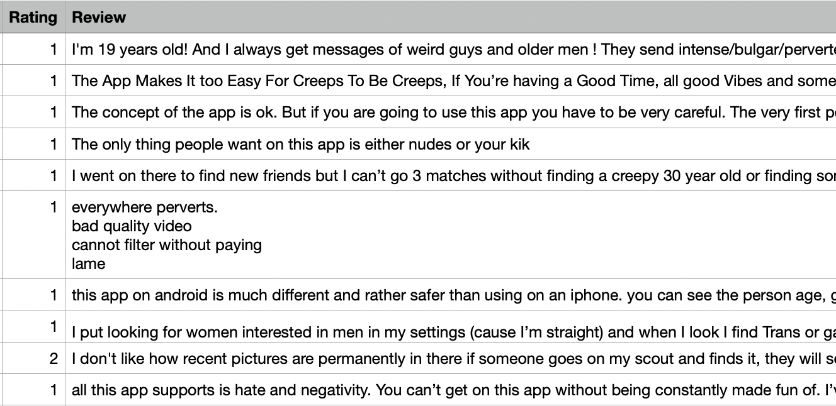
do it yourself
Notes:
Is an intern or a computer going to be better at understanding this?

Slide 42
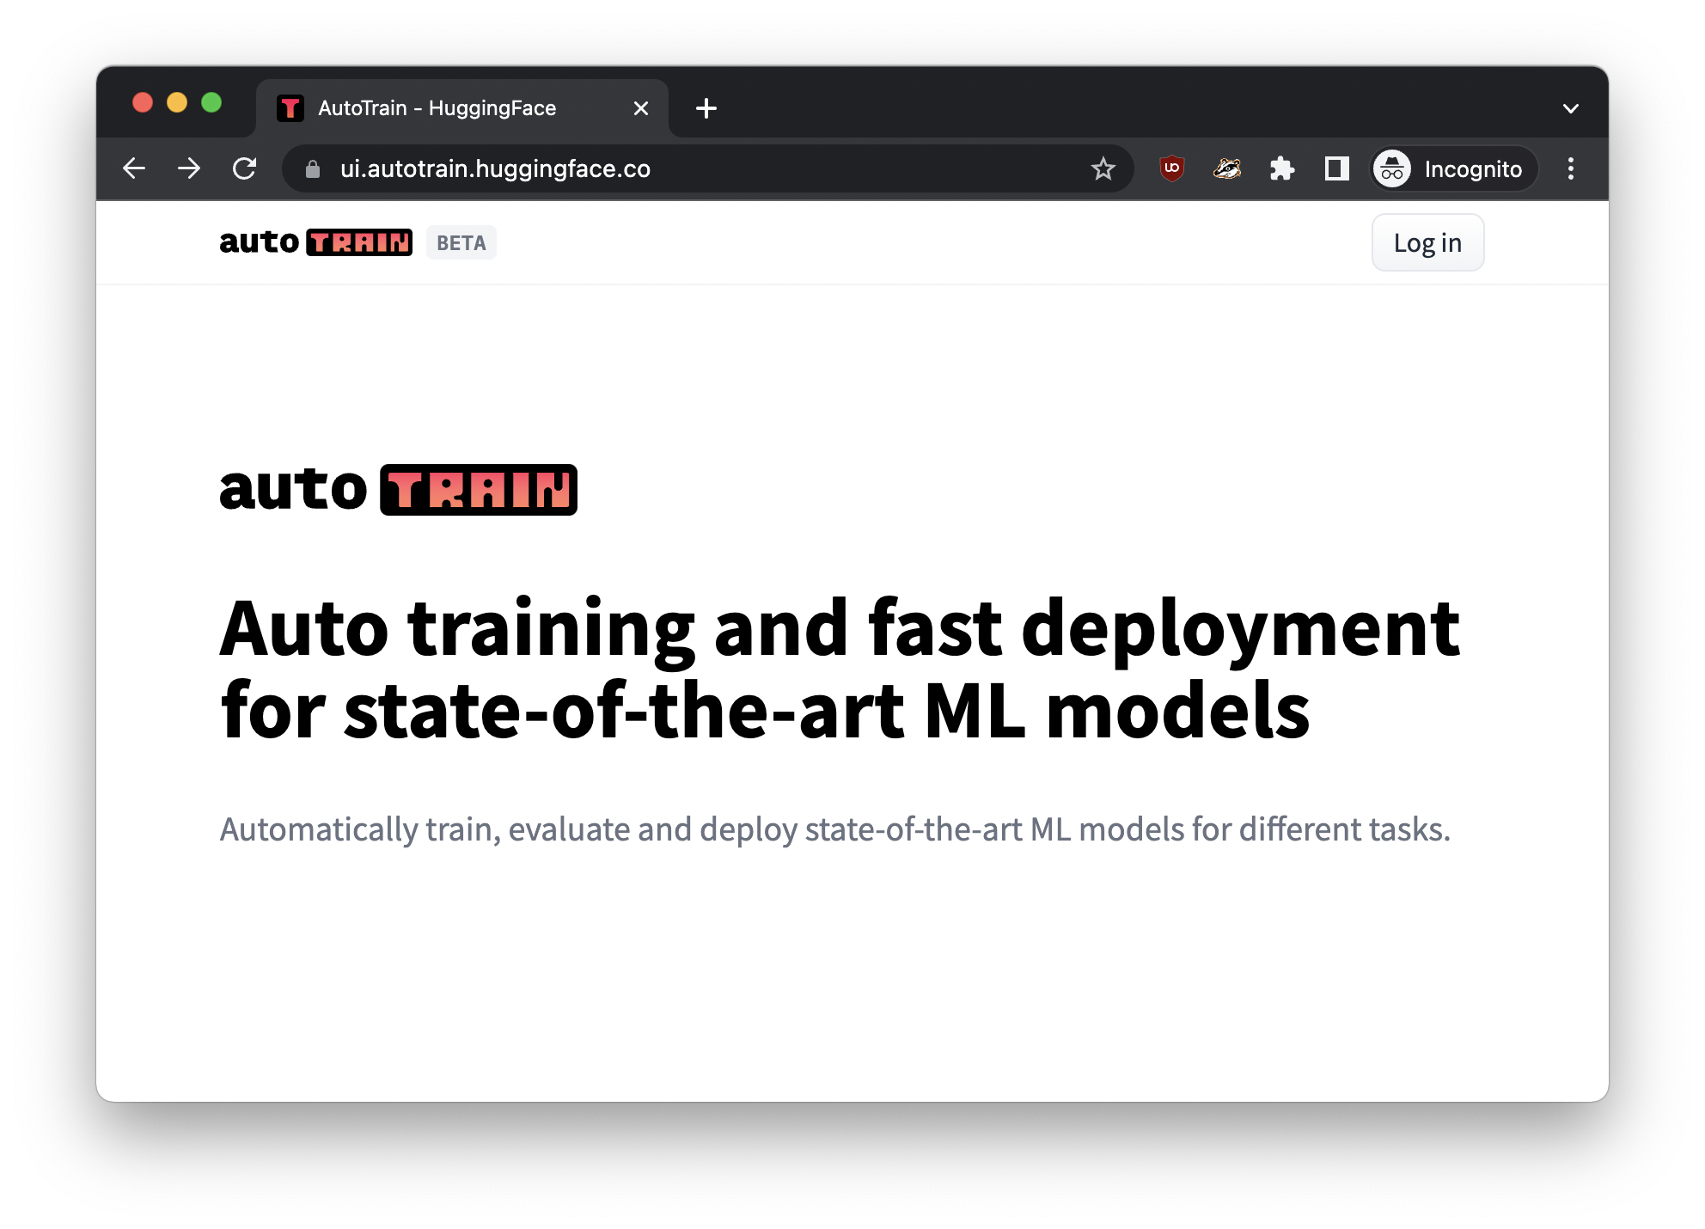
NO CODE? NO PROBLEM!
https://ui.autotrain.huggingface.co
Notes:
automl

Slide 43
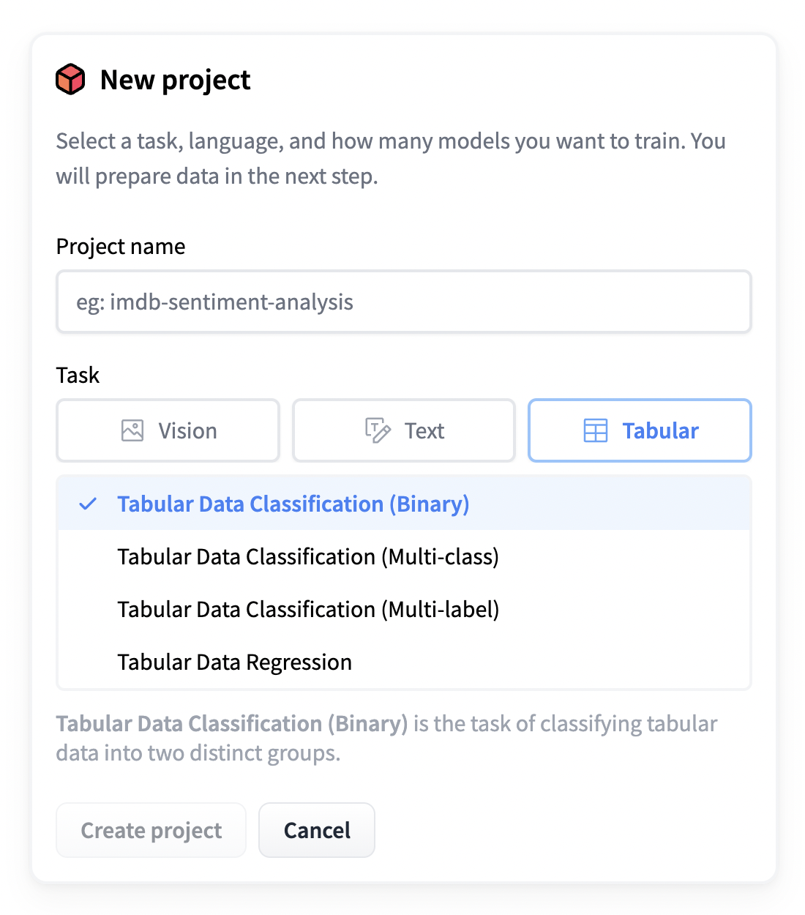


Slide 44
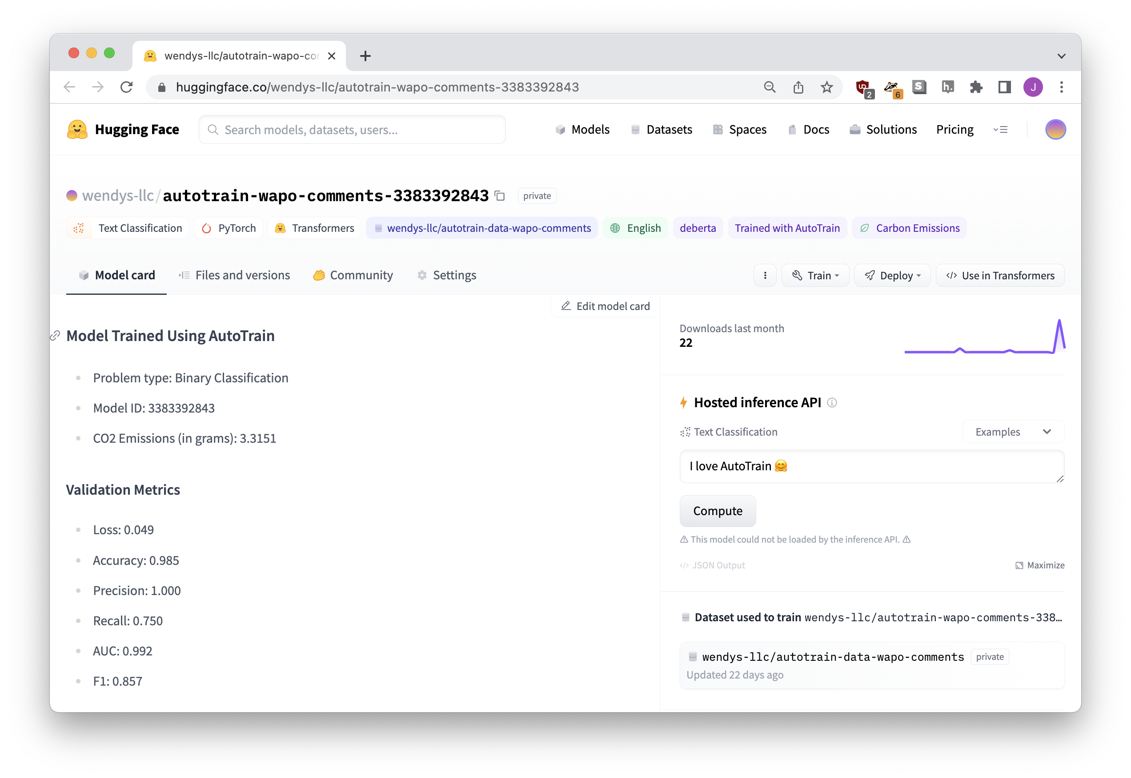


OUR FINE-TUNED MODEL!

Slide 45
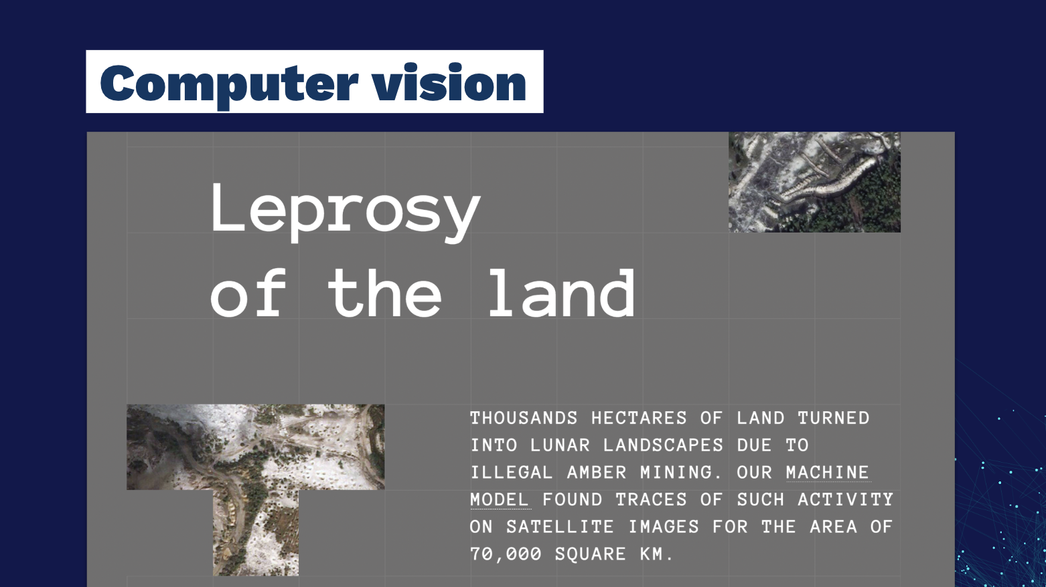
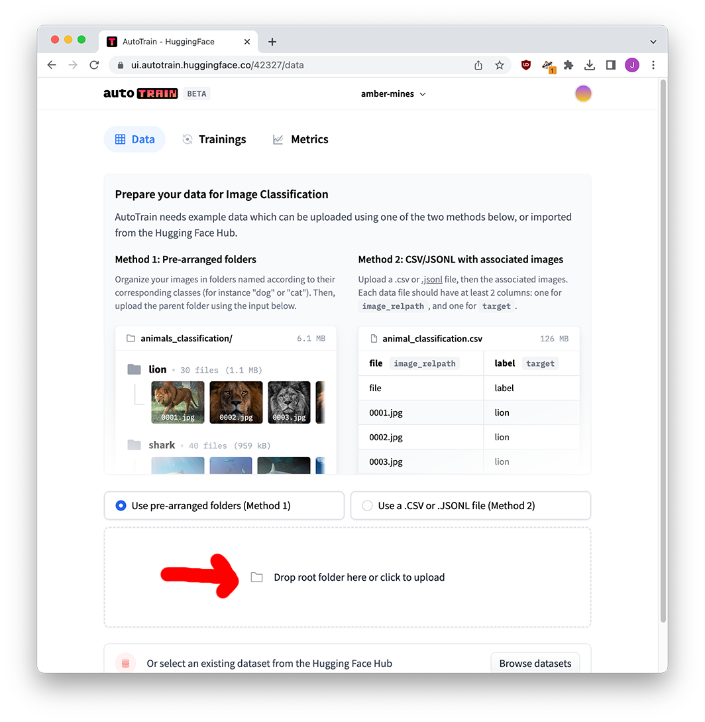
IMAGES, TOO

Slide 46
LLMs have changed everything
STEP FIVE

Slide 47
198 million
tweets
TRAINING
(to learn language)
I love to eat cookies is POSITIVE
OKAY NOW
WE USE IT!!!!
I hate when it rains is NEGATIVE
I’m feeling sick is NEGATIVE
Dogs are cool animals is POSITIVE
…… is …….
FINE TUNING
…… is …….
…… is …….
(to learn rules)

Slide 48


THE ENTIRE INTERNET
TRAINING
(to learn language)
OKAY NOW
WE USE IT!!!!
IT ALREADY
KNOWS EVERYTHING
(maybe this is scary???)

Slide 49
chat model
prompt
response

Slide 50
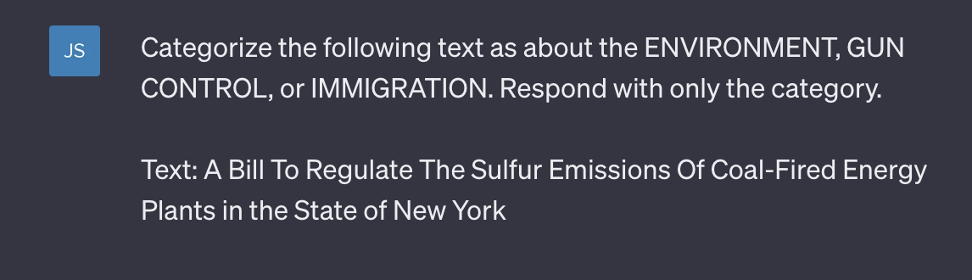


Slide 51
Did I train it?
NO!
Did I fine-tune it?
NO!
It just did the job!

Slide 52
zero-shot classification
(also, few-shot classification)

Slide 53
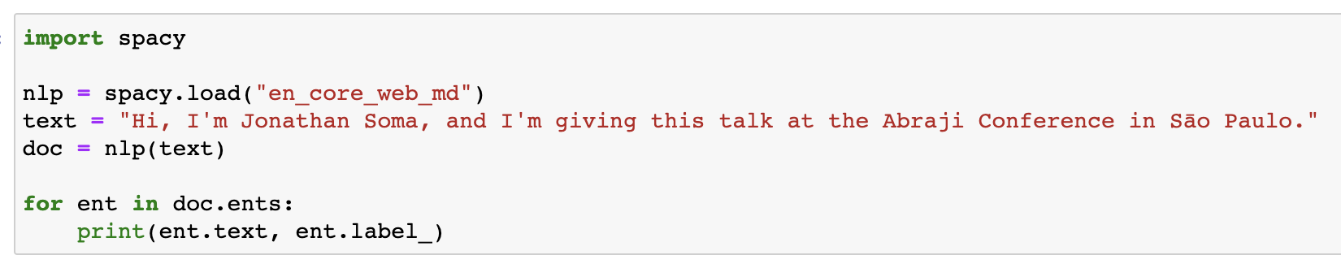
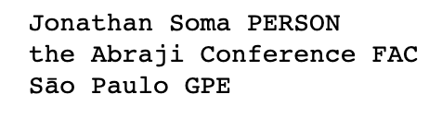
Named entity recognition

Slide 54
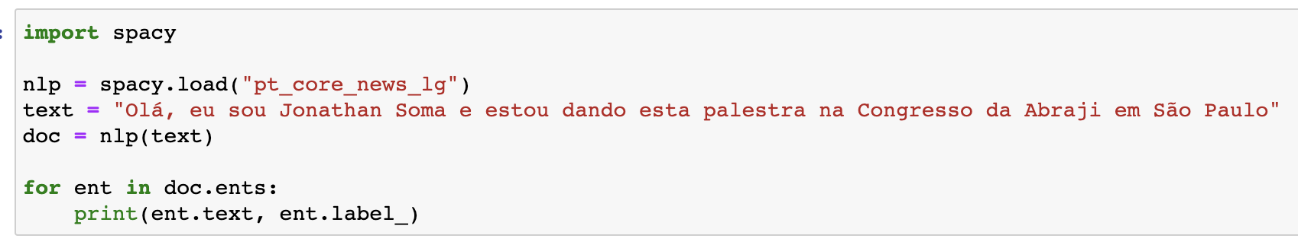
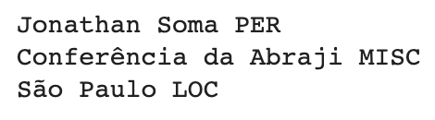

Named entity recognition

Slide 55
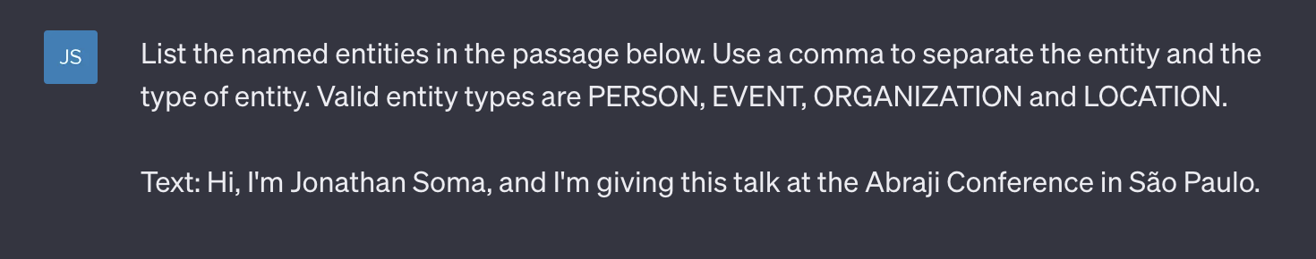
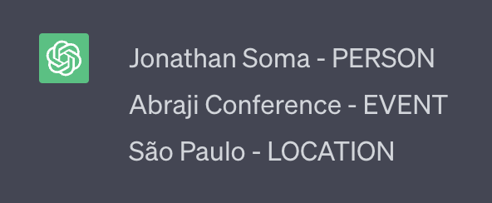

Slide 56
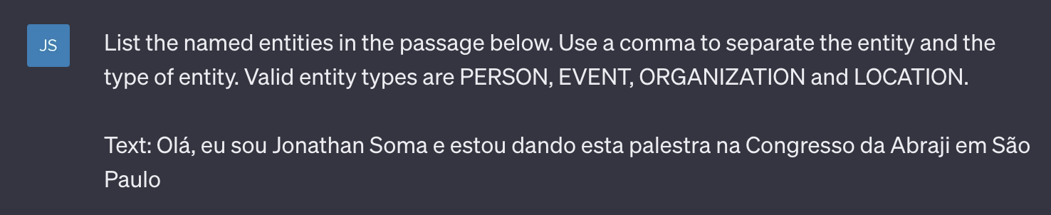
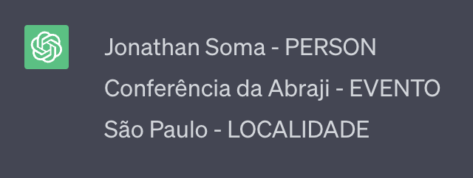


Slide 57
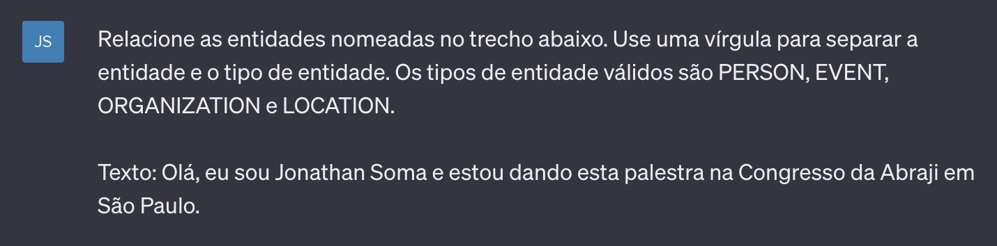
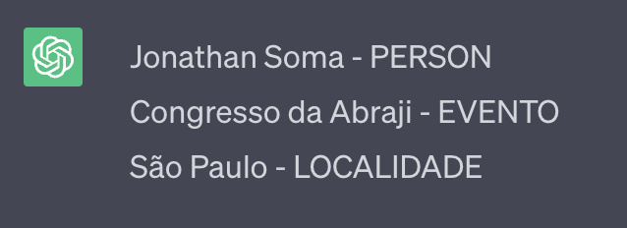

Slide 58
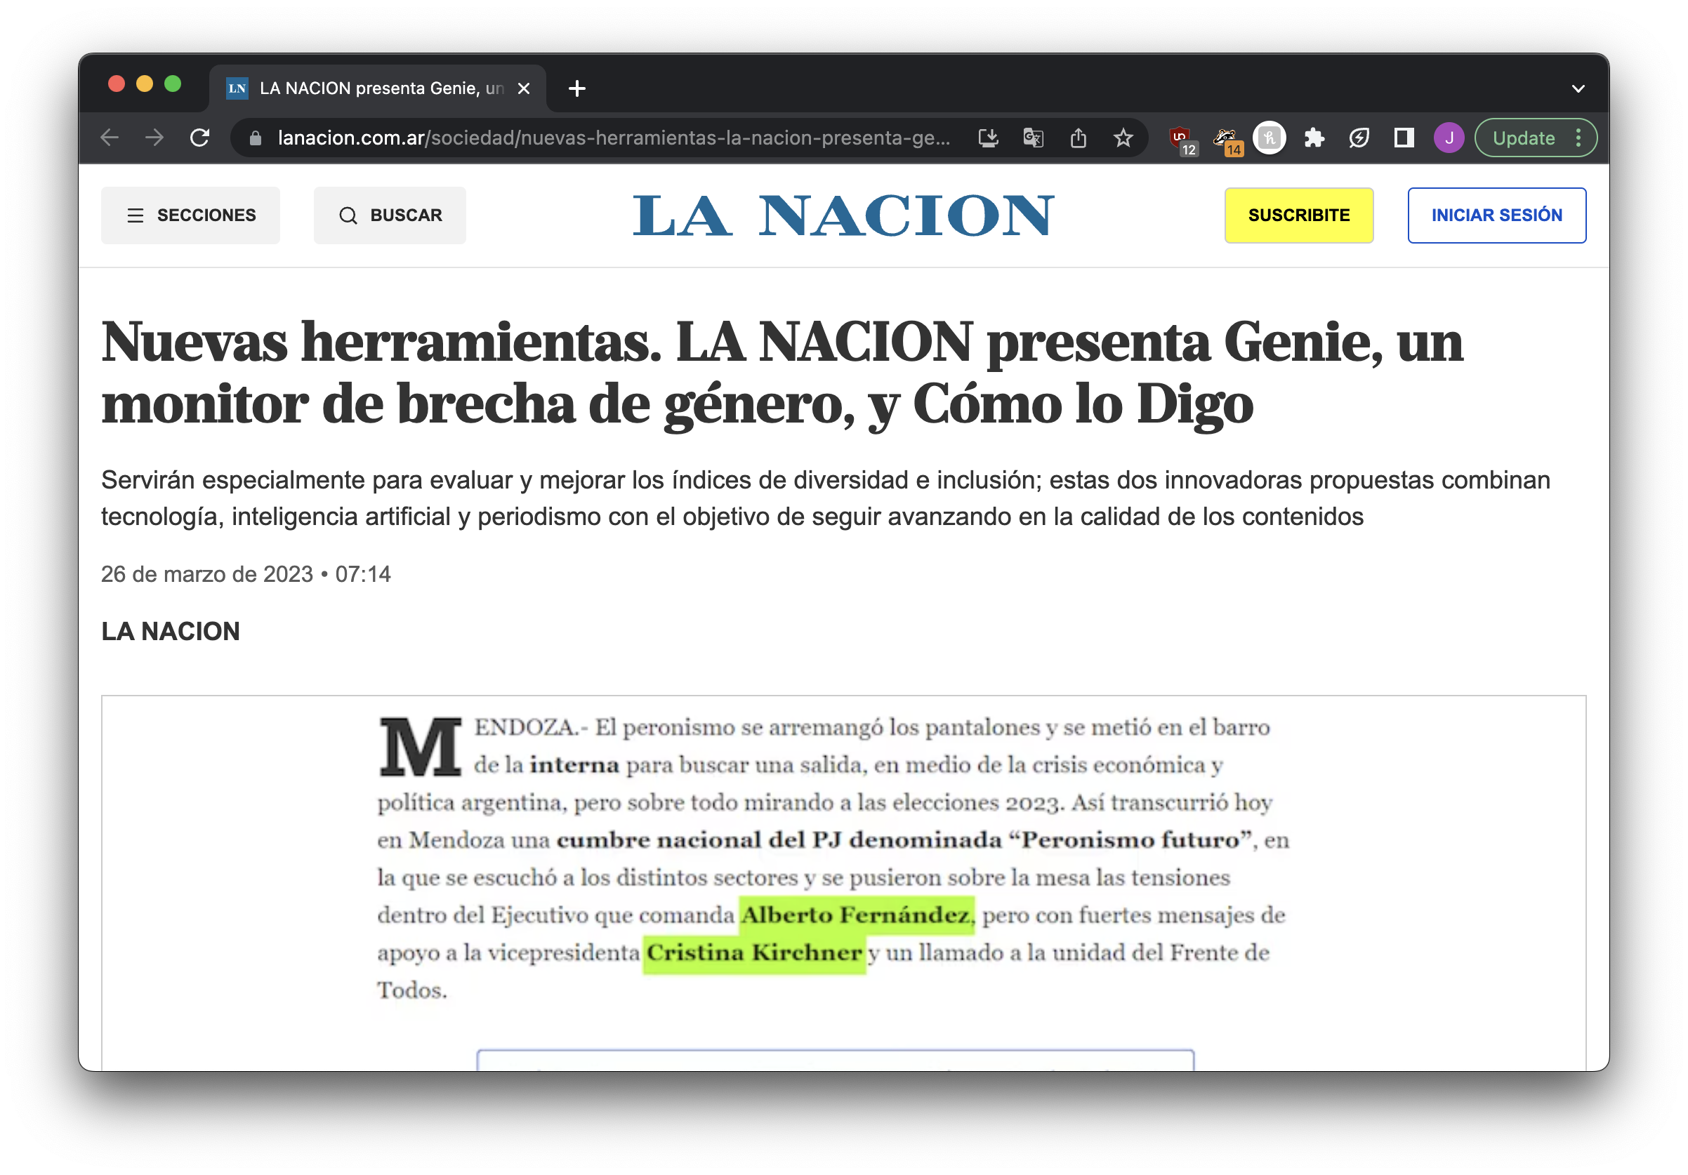
Use case: gender equity in sources

Slide 59
Limits of large language models
STEP SEVEN

Slide 60
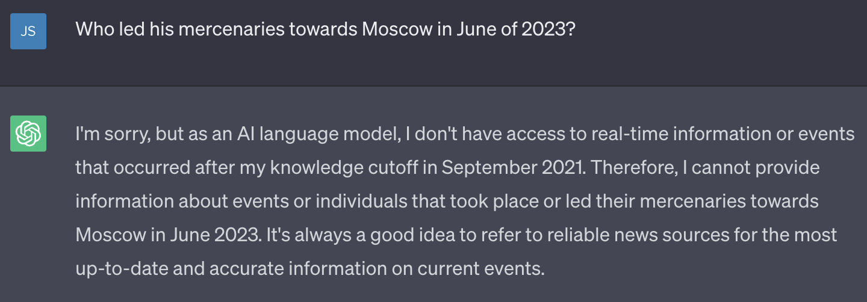
Knowledge cutoff

Slide 61
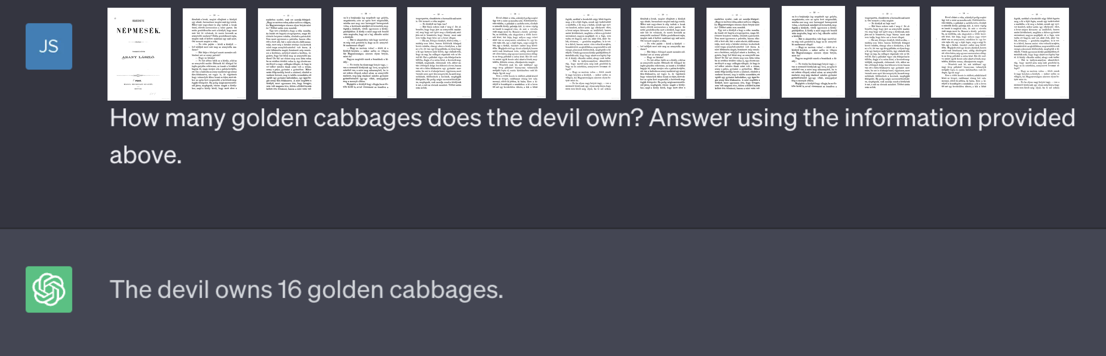




…just send it the info?
Please summarize this book and tell me all of the important things in it.
This isn’t actually possible!

Slide 62
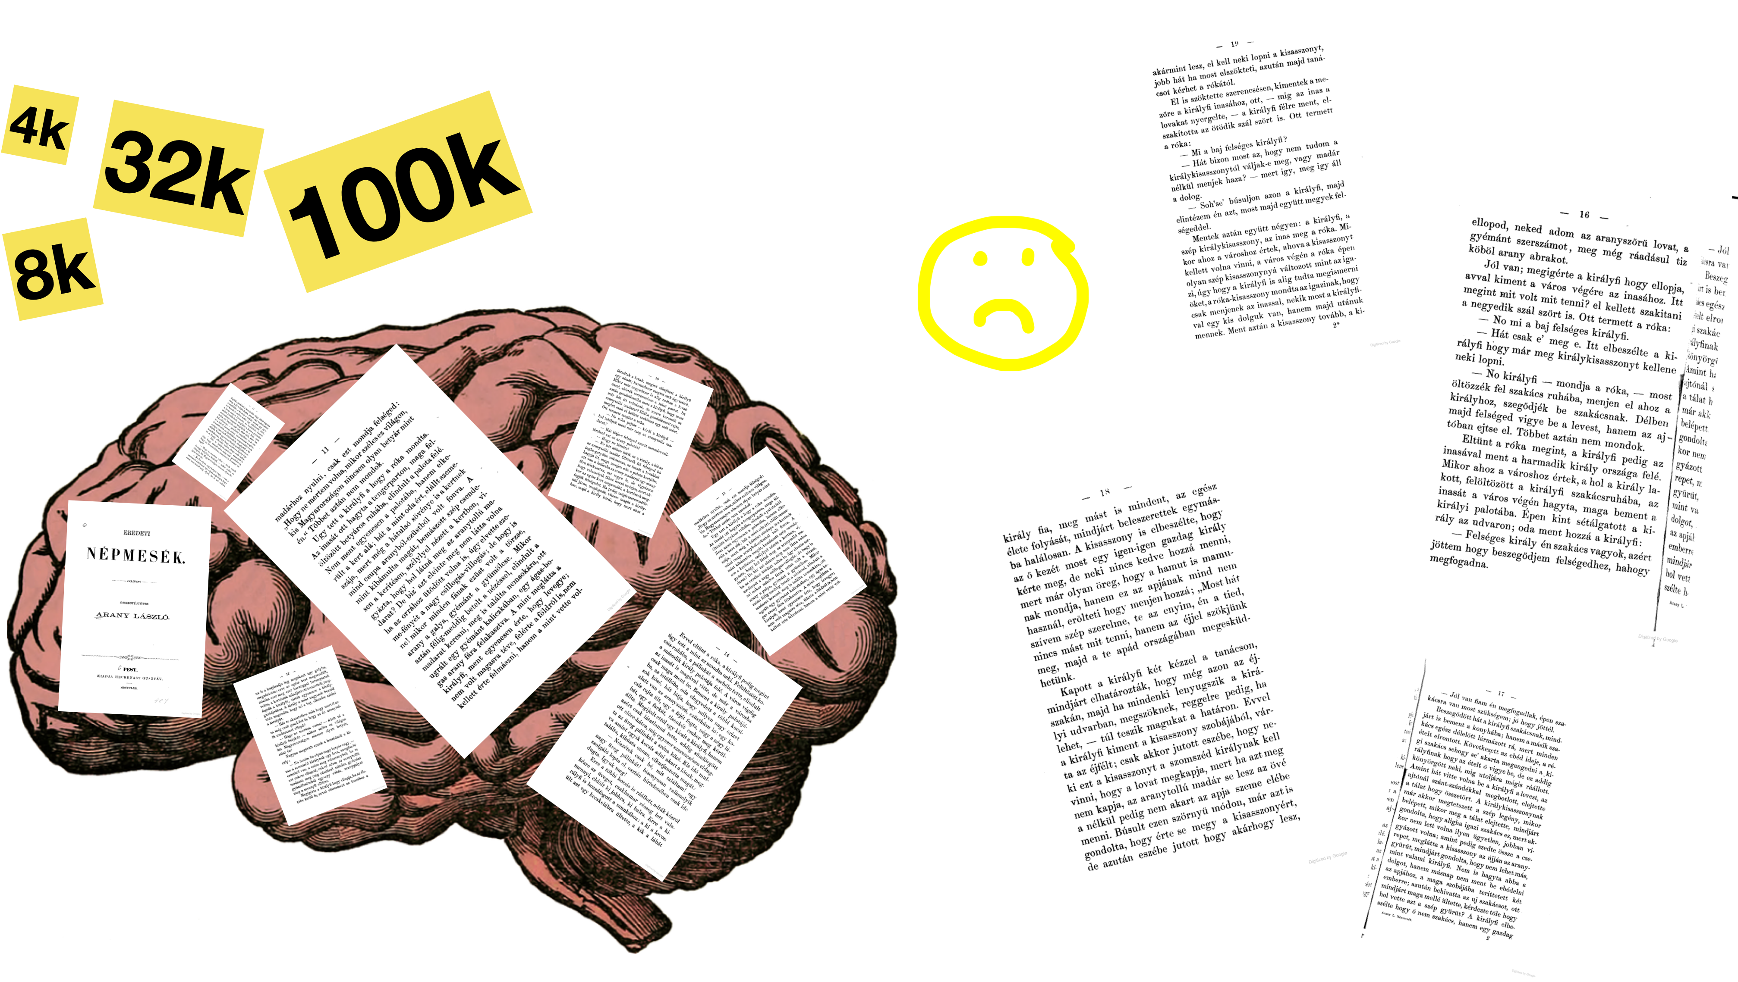
Token limits

Slide 63
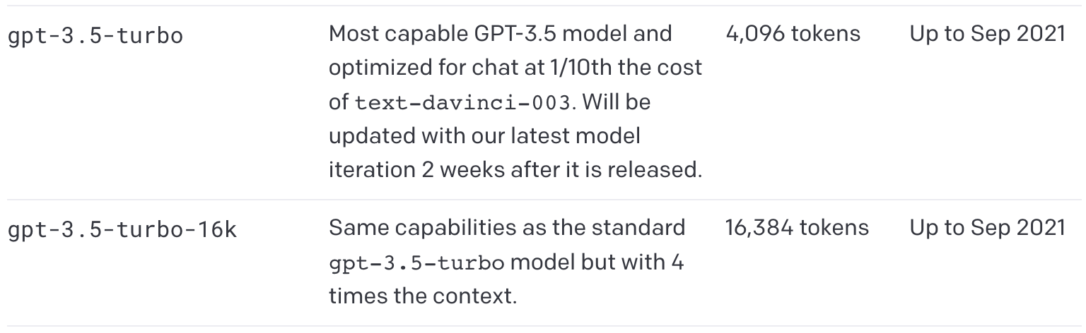
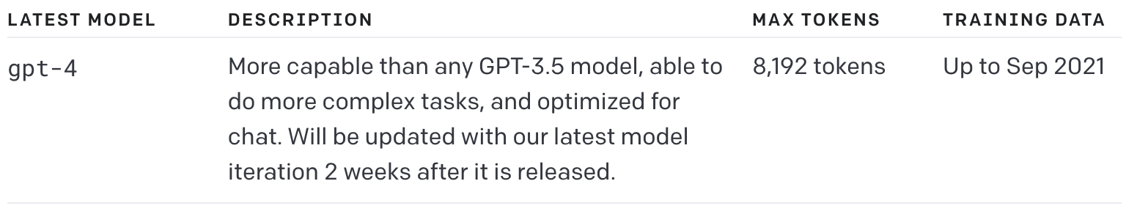
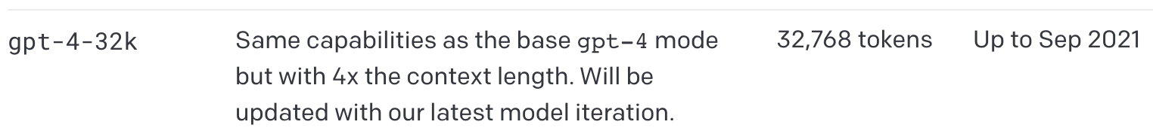

Slide 64
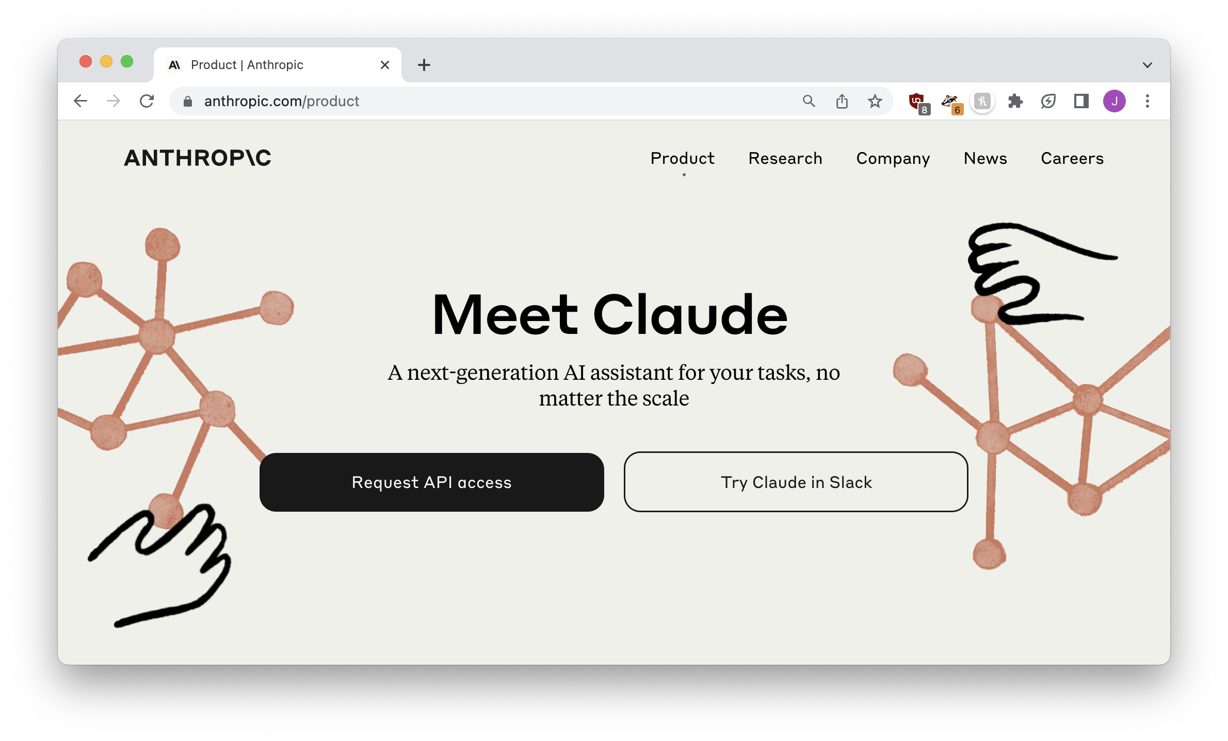
100k token limit
(there are also other ways around it)

Slide 65
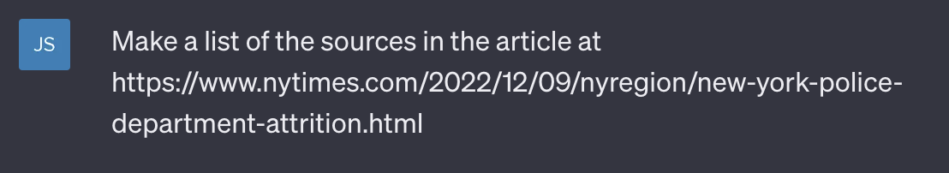
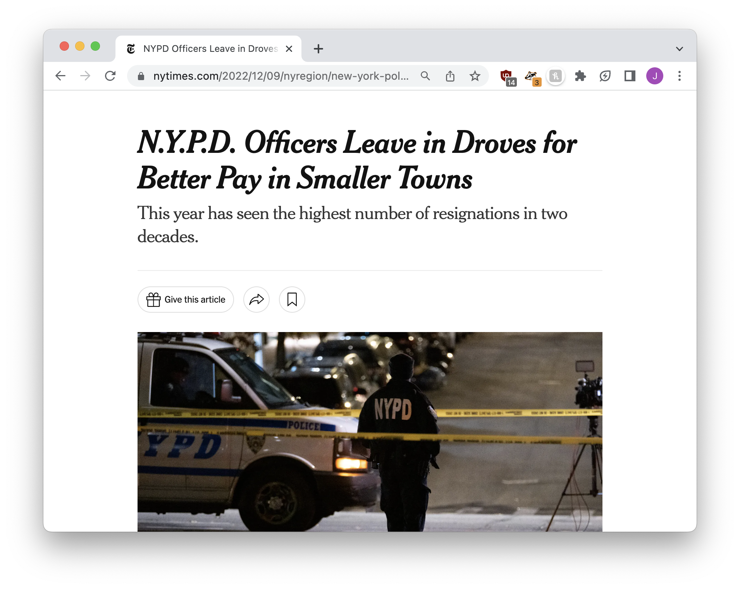
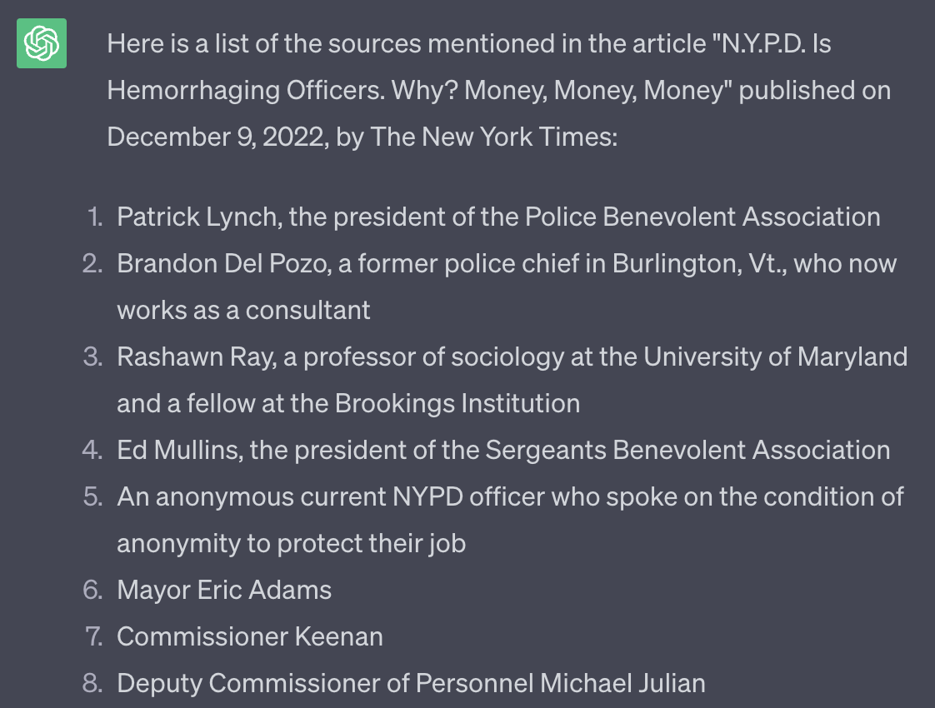

hallucinations

Slide 66
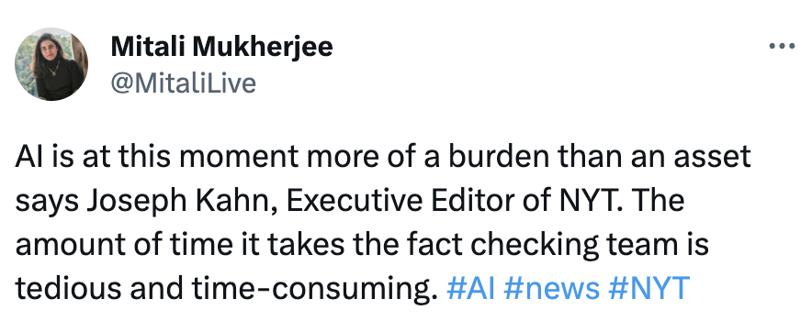
Art is more resilient to imperfections than journalism

Slide 67
What can models do?
STEP SEVEN

Slide 68
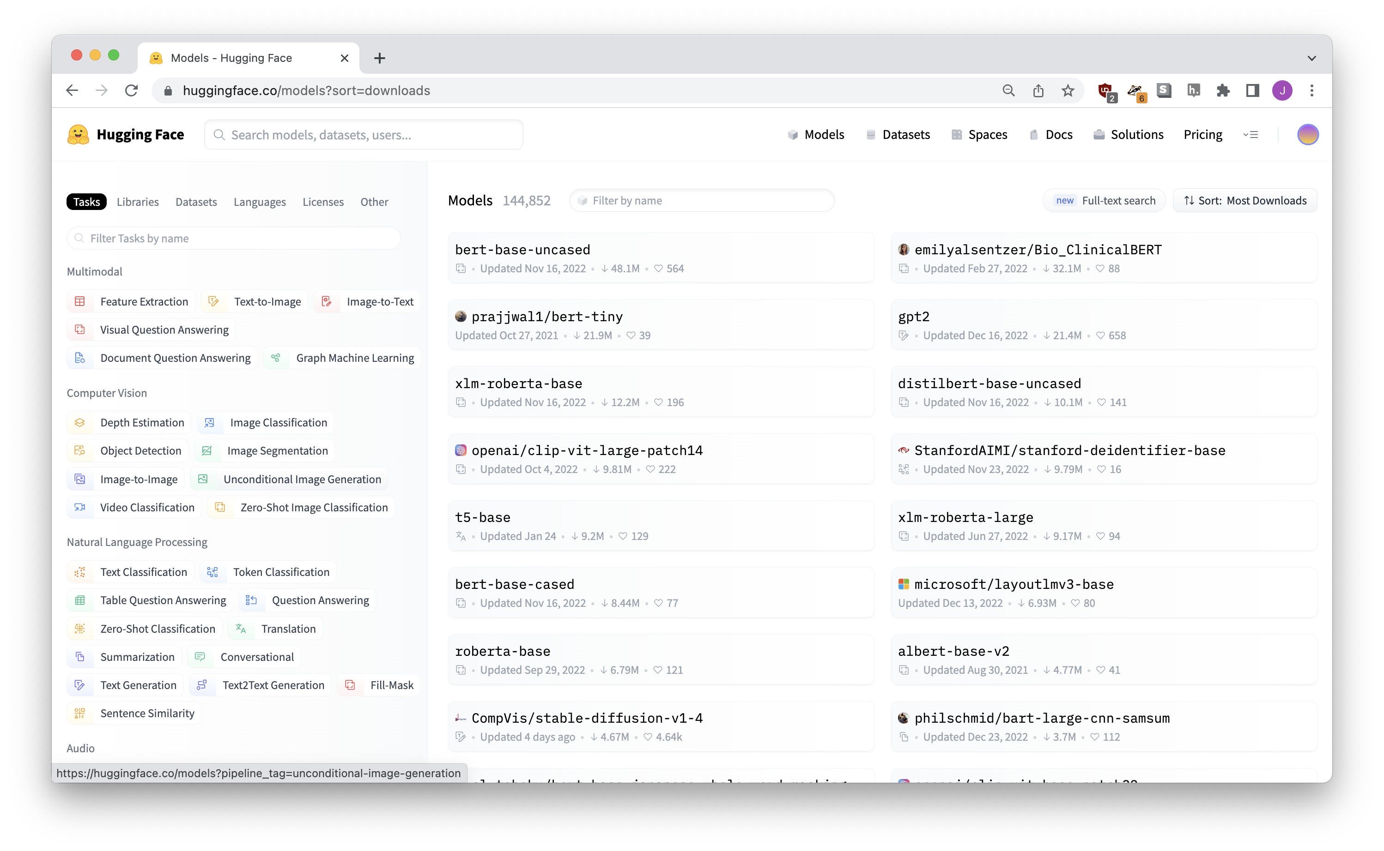
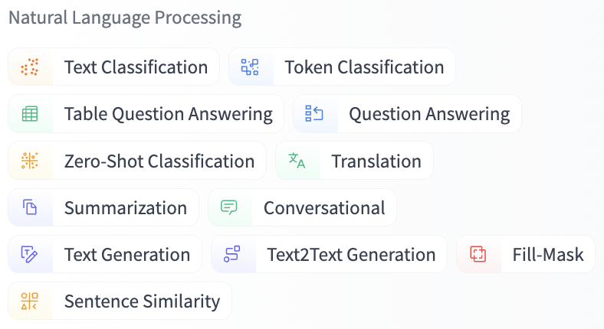

Slide 69
Models for images
STEP EIGHT

Slide 70
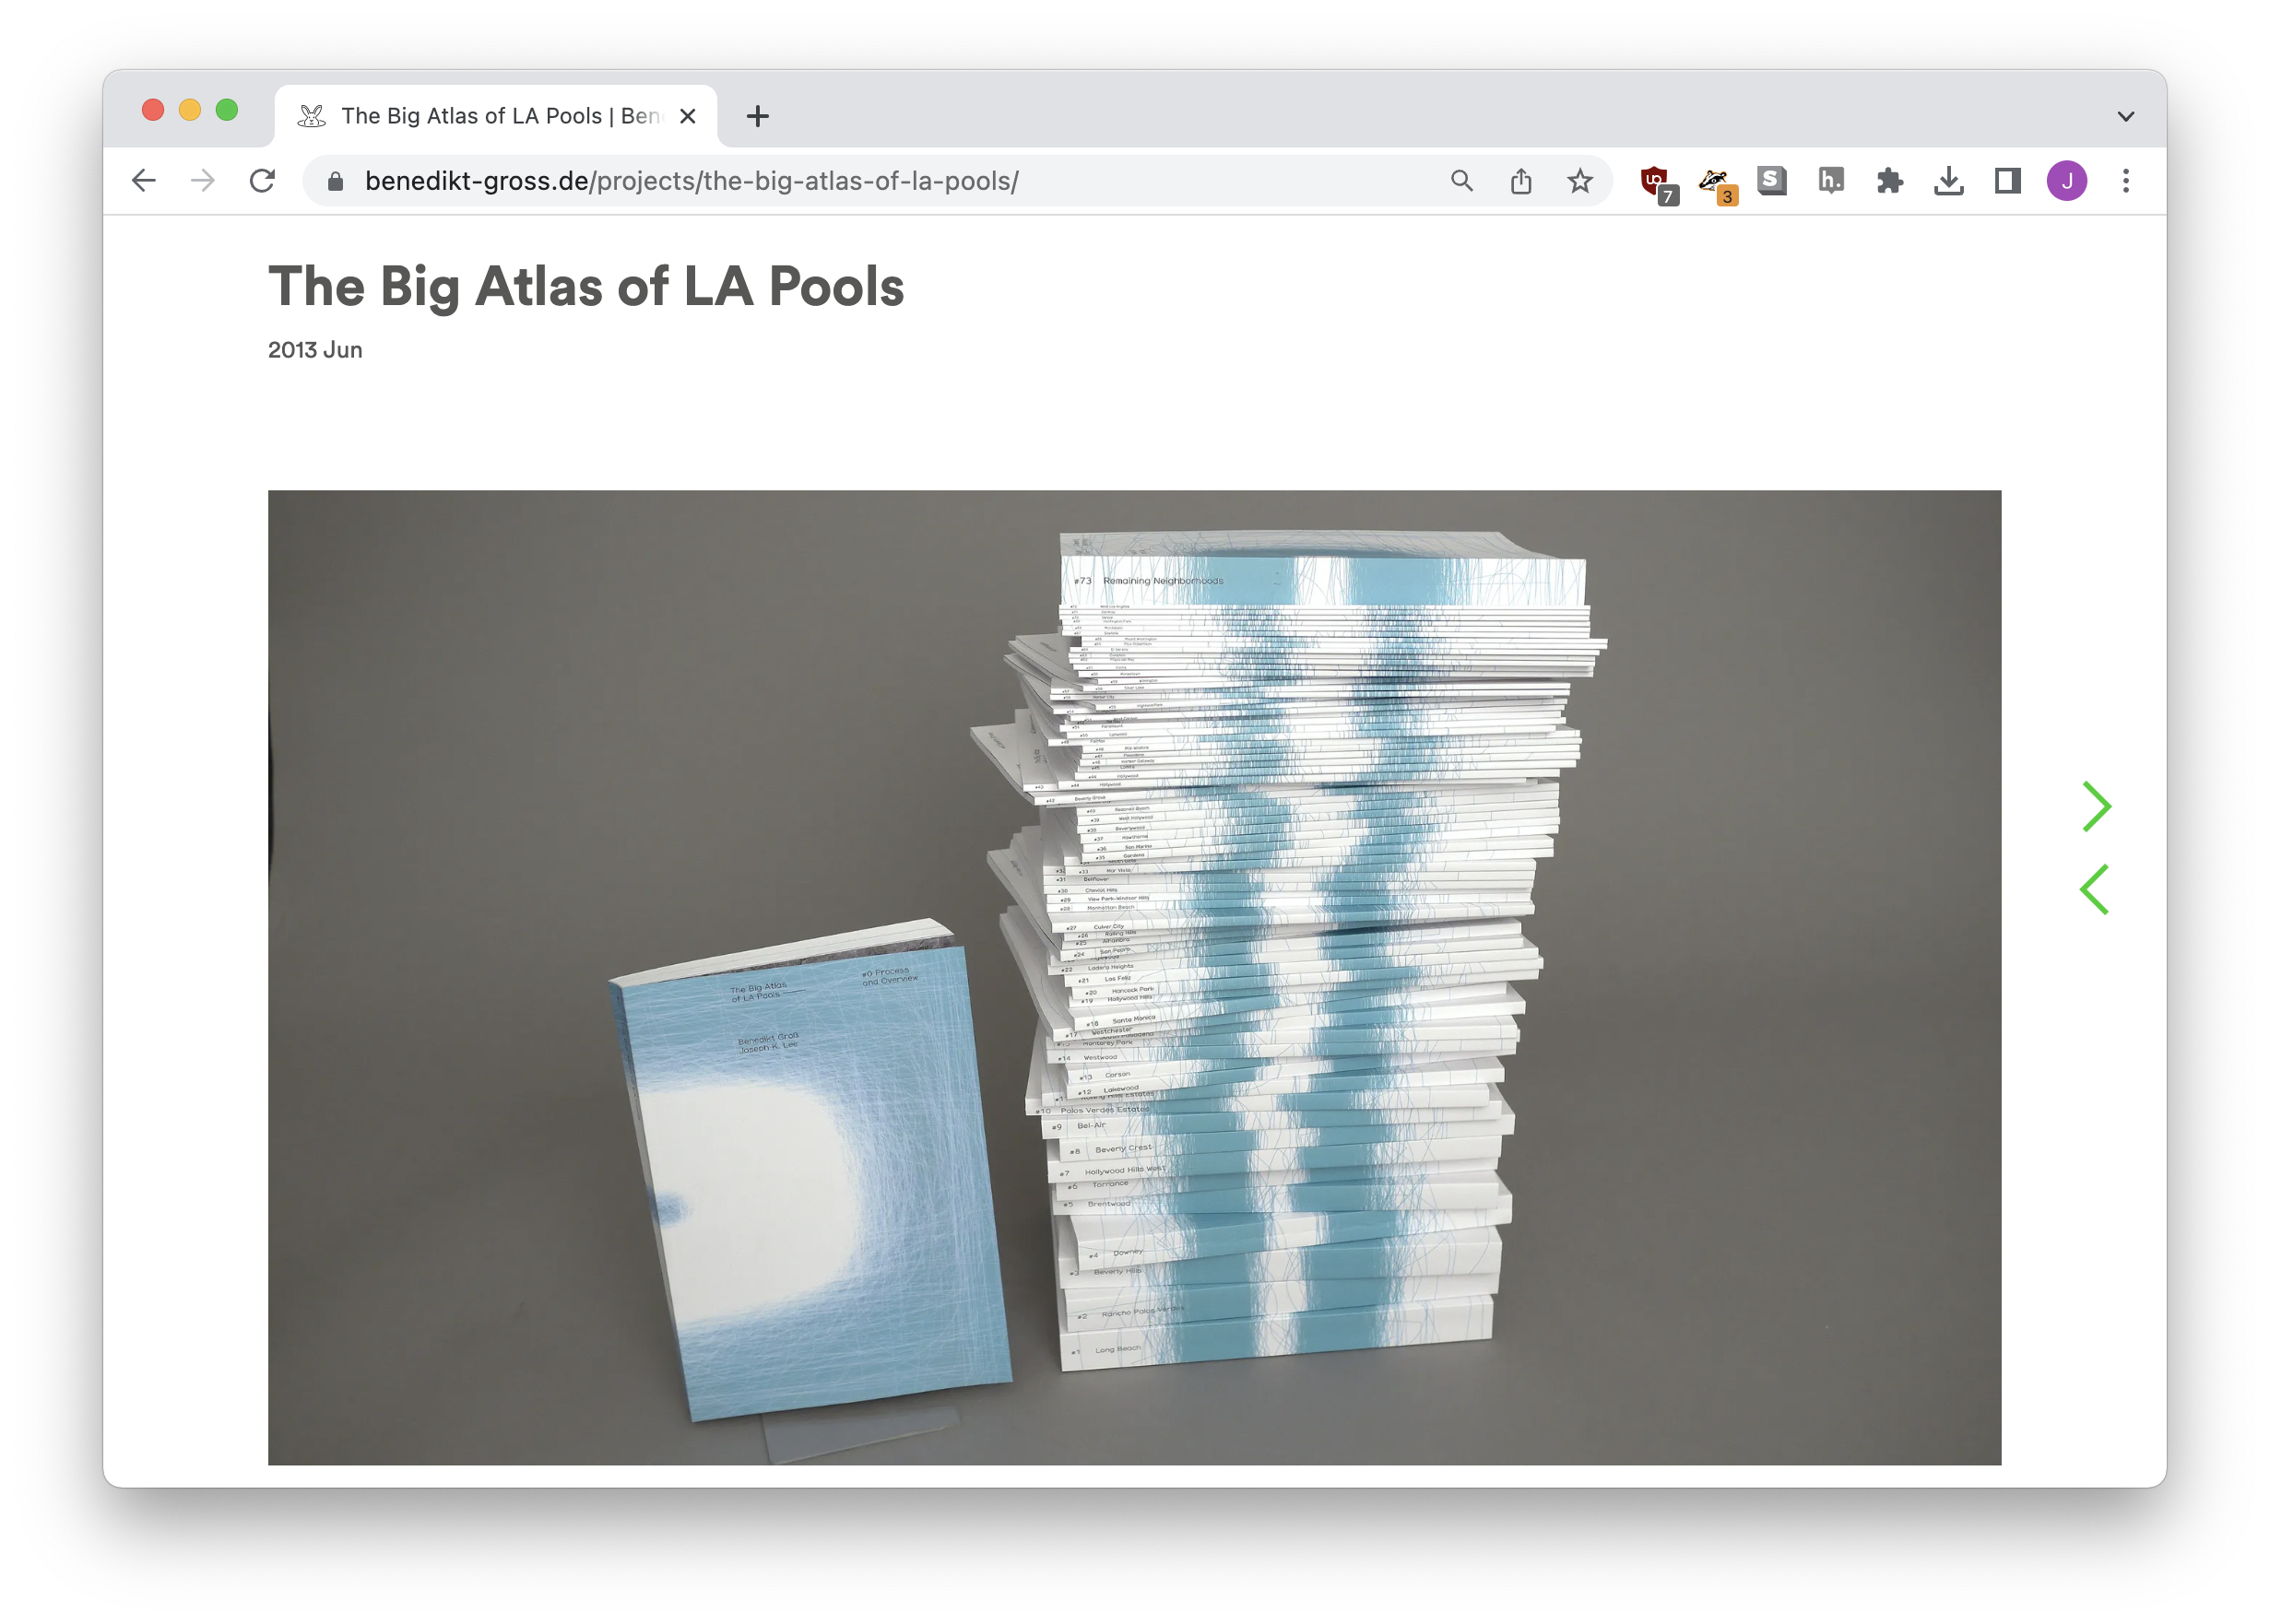
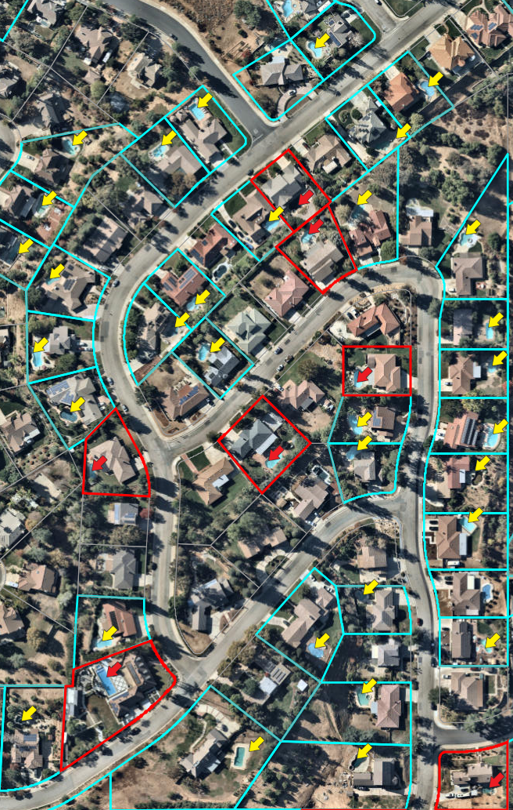
object detection

Slide 71

semantic segmentation
https://huggingface.co/spaces/thiagohersan/maskformer-coco-vegetation-gradio

Slide 72


investigate.ai

Slide 73


normalai.org

Slide 74

https://jsoma.github.io/2023-abraji-ai-workshop

Slide 75
An introduction to AI tools
jsoma.github.io/2023-abraji-ai-workshop
investigate.ai
normalai.org
Jonathan Soma
Columbia University
@dangerscarf
js4571@columbia.edu

